Slide 1
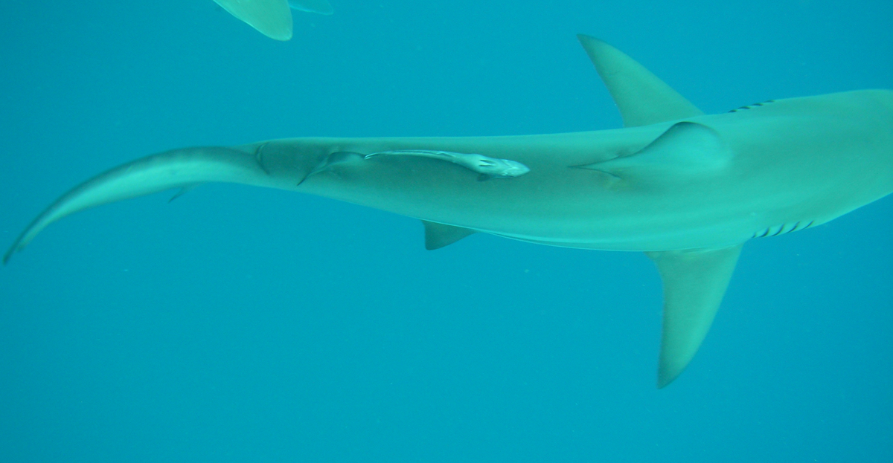
South African Shark Resources: Balancing Conservation and Commercial Use

Slide 2
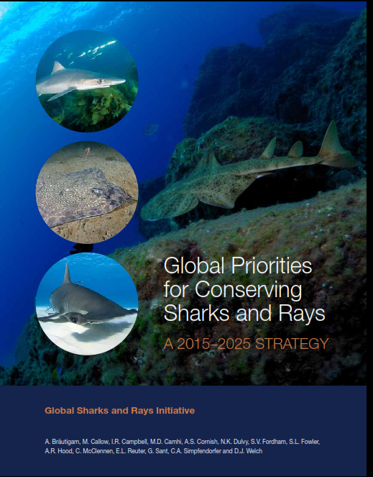
Sharks as a Resource
Rich diversity, high levels of endemism, intrinsic conservation value
Sharks are ecologically and economically valuable
Utilization can be extractive and non-extractive
Need for balance!
Notes:
South Africa is well regarded globally for its rich shark biodiversity and high levels of endemism.
As such shark species and biodiversity have an intrinsic value in terms of ecosystem integrity and conservation.
Further to this sharks have commercial value over several sectors, both extractive and non-extractive.
BALANCING THIS RESOURCE ACROSS THESE INTERESTS IS NECESSARY

Slide 3
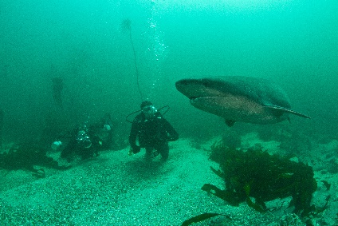
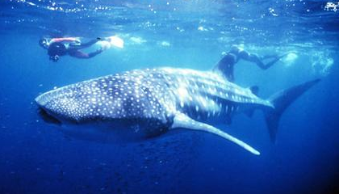
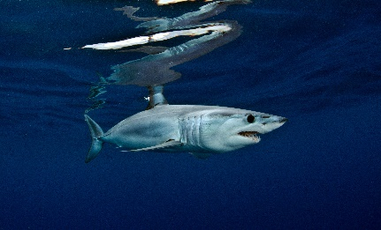
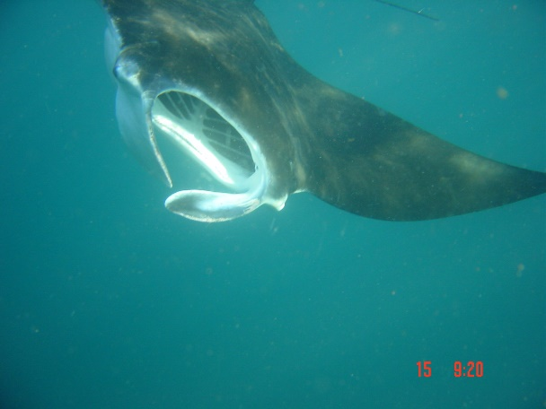
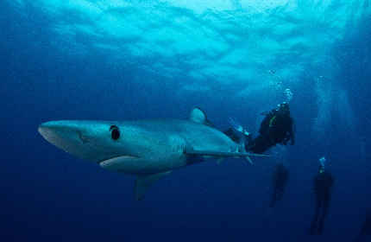
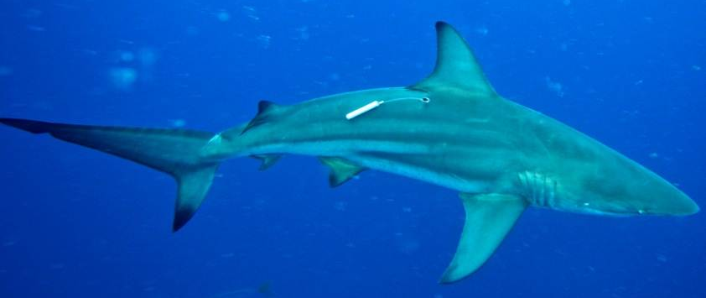
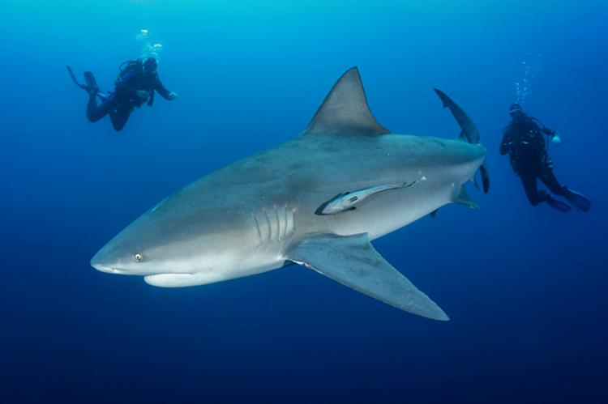
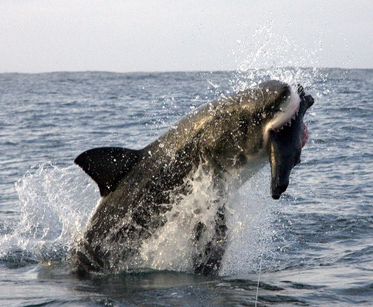
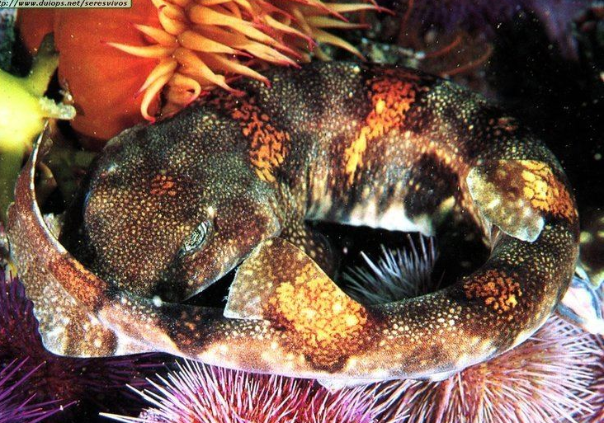
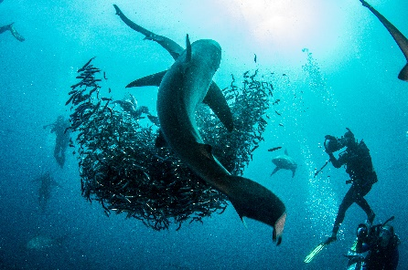
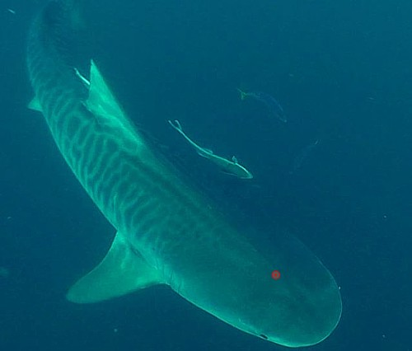
Shark Tourism in South Africa
KZN
Tiger Shark
Raggedtooth Shark
Black Tip Shark
Zambezi/ Bull Shark
Whale Shark
Manta Rays
Western Cape
Great White Shark
Cow Sharks
Mako & Blue Shark
Shysharks & Pajama Shark (Endemics)
Eastern Cape
Raggedtooth Shark
Great white Shark
Carcharinids associated with “Sardine Run”
Notes:
So my Colleague Charlene has covered the Extractive Use in Fisheries and I will tackle the Non- Extractive Tourism Aspect
Shark Tourism Activities in SA to have a species and area specific focus
Explain The focus animals and areas

Slide 4
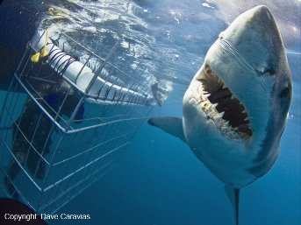
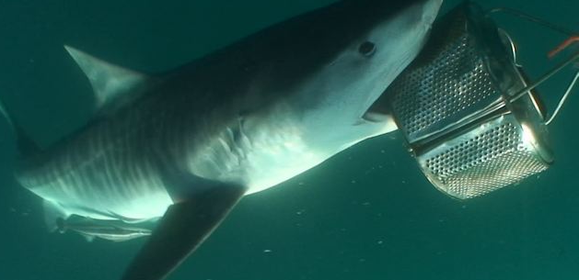
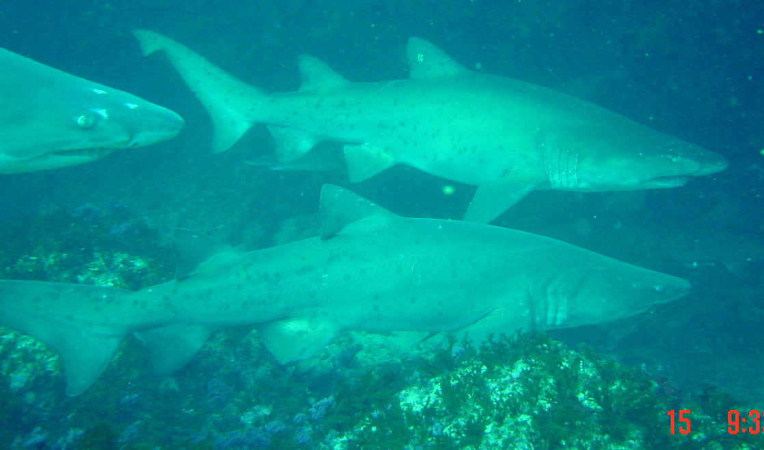
Types of Tourism activities
Shark cage diving
SCUBA diving and snorkeling (no cage)
Boat-based vs shore-based
Activities based on artificial attraction (Chumming)
Activities based on Natural aggregations (according to natural spatio-temporal patterns)
Different Activities Different Impacts
Notes:
There are different methods that are used by Shark Tourism Operators to facilitate interaction between client and the focus animal.
Use of cages for safety or snorkel and scuba outside the cage to create a more intimate opportunity to interact and view animals
Sites can be accessed via shore or require use of vessels
These vary according to the experience being offered and practicalities of the area of operation
Chumming involves the use of fish/fish oil to create a scent path or slick which attracts animals into viewing proximity aggregating them within the chum area eg.Tigers in aliwal zmbezi and tiger sharks in protea banks and white shark cage diving
Some species of shark aggregate naturally as part of their life history eg Raggedtooth sharks during their mating and gestation period or shark aggregations around feeding events like the sardine run
Both natural and artificial aggregation tourism have their own sets of impacts which require different mitigation measures to avoid conflict with other users or have a negative ecological impact

Slide 5
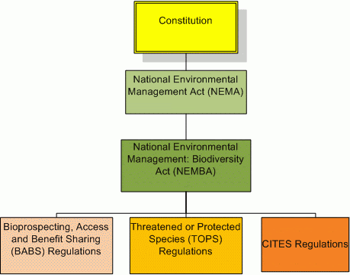
Shark tourism in South Africa (cont.)
Available legislation
White shark cage diving regulations
Spatial Restrictions e.g. MPA’s
Threatened and or Protected Species (TOPS)
Others legislated as ‘restricted activities’ and regulated via permit conditions and “Code of Conduct”
Notes:
In order to manage and mitigate the impacts of tourism activities we need to make use of existing Legislative tools
AND WHERE NECESSARY review legislation to create better tools
WSCD is one of the most established tourism sectors and so has quite a systematic set of Regulations that have been revised and improved since its first gazetting in 1998 to the most recent policy published in 2017
Protected Areas, Protected species and Restricted activity provisions within NEMBA allow the dept. to permit tourism activities under specific conditions that minimize their impact on other user groups, the species and the general ecology of an area
Permits also allow for implementation of Best Practice guidelines and accepted code of conduct

Slide 6
Eco tourism and consumptive use: The need to work with diverse stakeholders
Example 1: Bather Safety vs Cage diving industry and chumming
Spike in Shark attacks in False Bay 2009 to 2012
Response:
Engagement with municipal government, beach tourism representatives, cage diving industry, KZN Sharks Board and local lifesaving association
Chumming regulation amended, restriction placed of the amount of chum that can be used per trip
Notes:
Conflict can occur when there is an overlap of users across activities, species and areas!
Conflict usually arises when there is some form of overlap of either activities areas of operation and or focal species.
Finding resolution requires engagement with all sectors involved
A spike in shark attacks “shark interactions” in False Bay between 2009 and 2012 created tensions between beach users and the white shark Cage Diving industry in the area.
There was a perception the chumming activities at seal Island false bay may be attracting more sharks into the inshore area.
The municipality and beach tourism industry was validly concerned about the safety of bathers and beach tourism within affected coastal towns
While no link between the two has been found, Discussions lead to the City of Cape Town initiating the Shark Spotters program and deploying a shark exclusion barrier in fishoek.
The dept as a precautionary measure decreased the amout of chum that could be used by the the cage diving operators

Slide 7
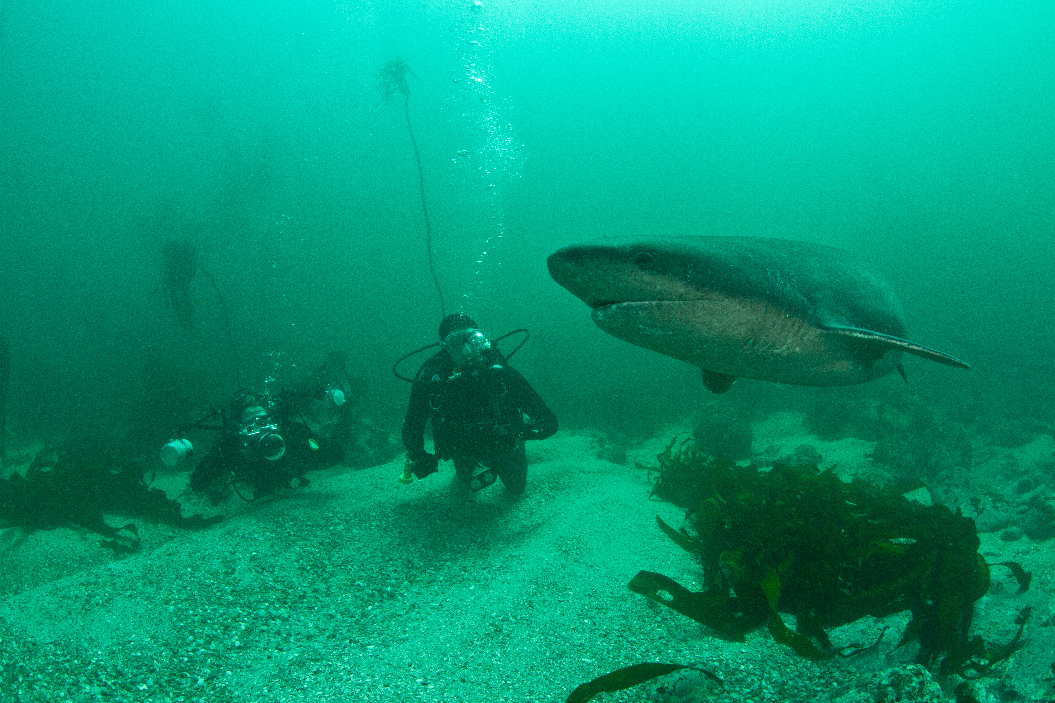
Eco tourism and consumptive use: The need to work with diverse stakeholders (continued)
Example 2: Sevengill Shark (Cow Shark) Fisheries vs Tourism
Species is of little value for fishers
Livers initially used as chum for cage diving
Response:
Change in cage diving permit conditions restrict chumming to bony fishes
Change in shark fishing permit conditions removes this species as a target
This species moved to non-consumptive use where it has become an iconic species for recreational diving and snorkelling
Notes:
Cow Sharks were incidentally viewed species within general kelp scuba tours but also a commercially harvested species.
Liver oil from processing of the carcass was also used by the cage diving industry as chum
After engagement with Commercial Fishers agreement was reached that this low value species had a greater non-consumptive value and it was removed as a commercially targeted species and has now become a iconic species for recreational scuba divers

Slide 8
Example 3:Spatial overlap between traditional line fishers & WSCD operators
Eco tourism and consumptive use: The need to work with diverse stakeholders (continued)
Spatial overlap between cage diving and traditional fishing
Incompatible activities
Response:
Stakeholder Engagements
Agreement on measures to take forward
Cage diving permits amended:
Move-Off rule and proximity to cage diving vessels (500m)
Change in Shark Size Slot limit (pending)
Notes:
Conflict arose between Commercial Line Fishers and WSCD operators over the overlap of activities within the geldsteen shallow reef complex.
Fishers began catching large Bronze whaler sharks within view of the Cage Diving Operators which resulted in an escalation of tensions between both user groups and a decline in the Cage Diving industries ability to provide a positive ecotourism experience
Between January and Early March 2020 OCR and Fisheries attempted to break the deadlock between stakeholder and their willingness to make compromises .
Short medium and longterm recommendations were generated after extensive consultation. Immediate actions implementation through the permits of both sectors in early March.
Medium term recommendations involve incorporating these issues in Spatial Planning Processes to assist with Managing incompatible activities and sectors of use.

Slide 9
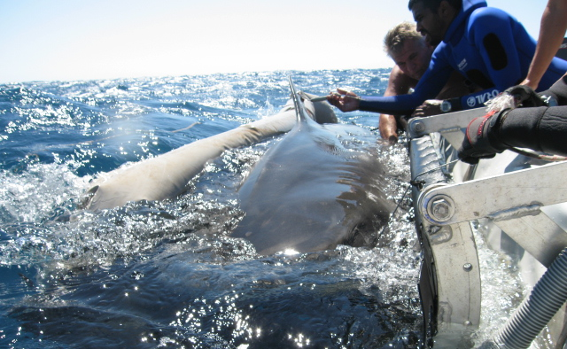
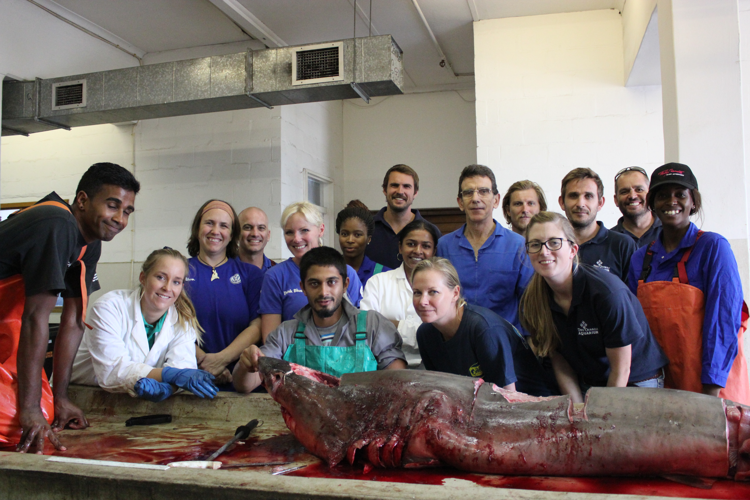
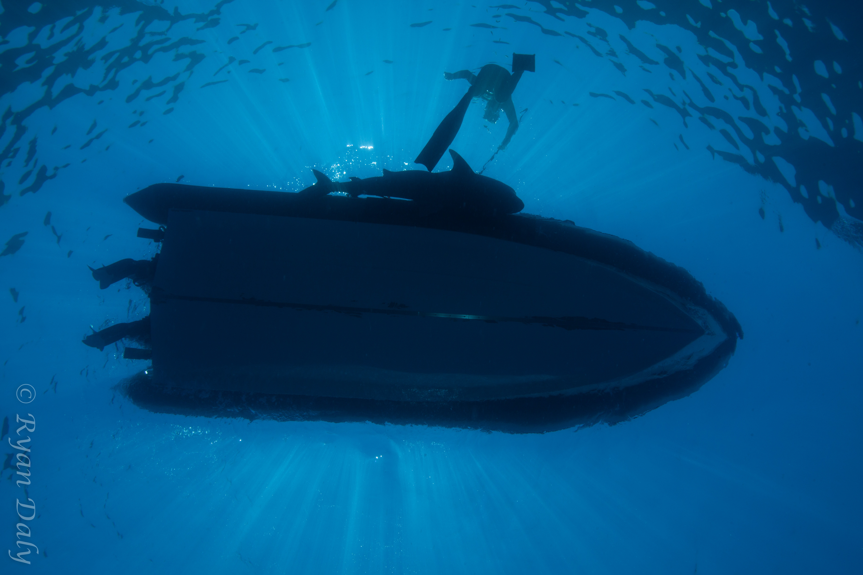
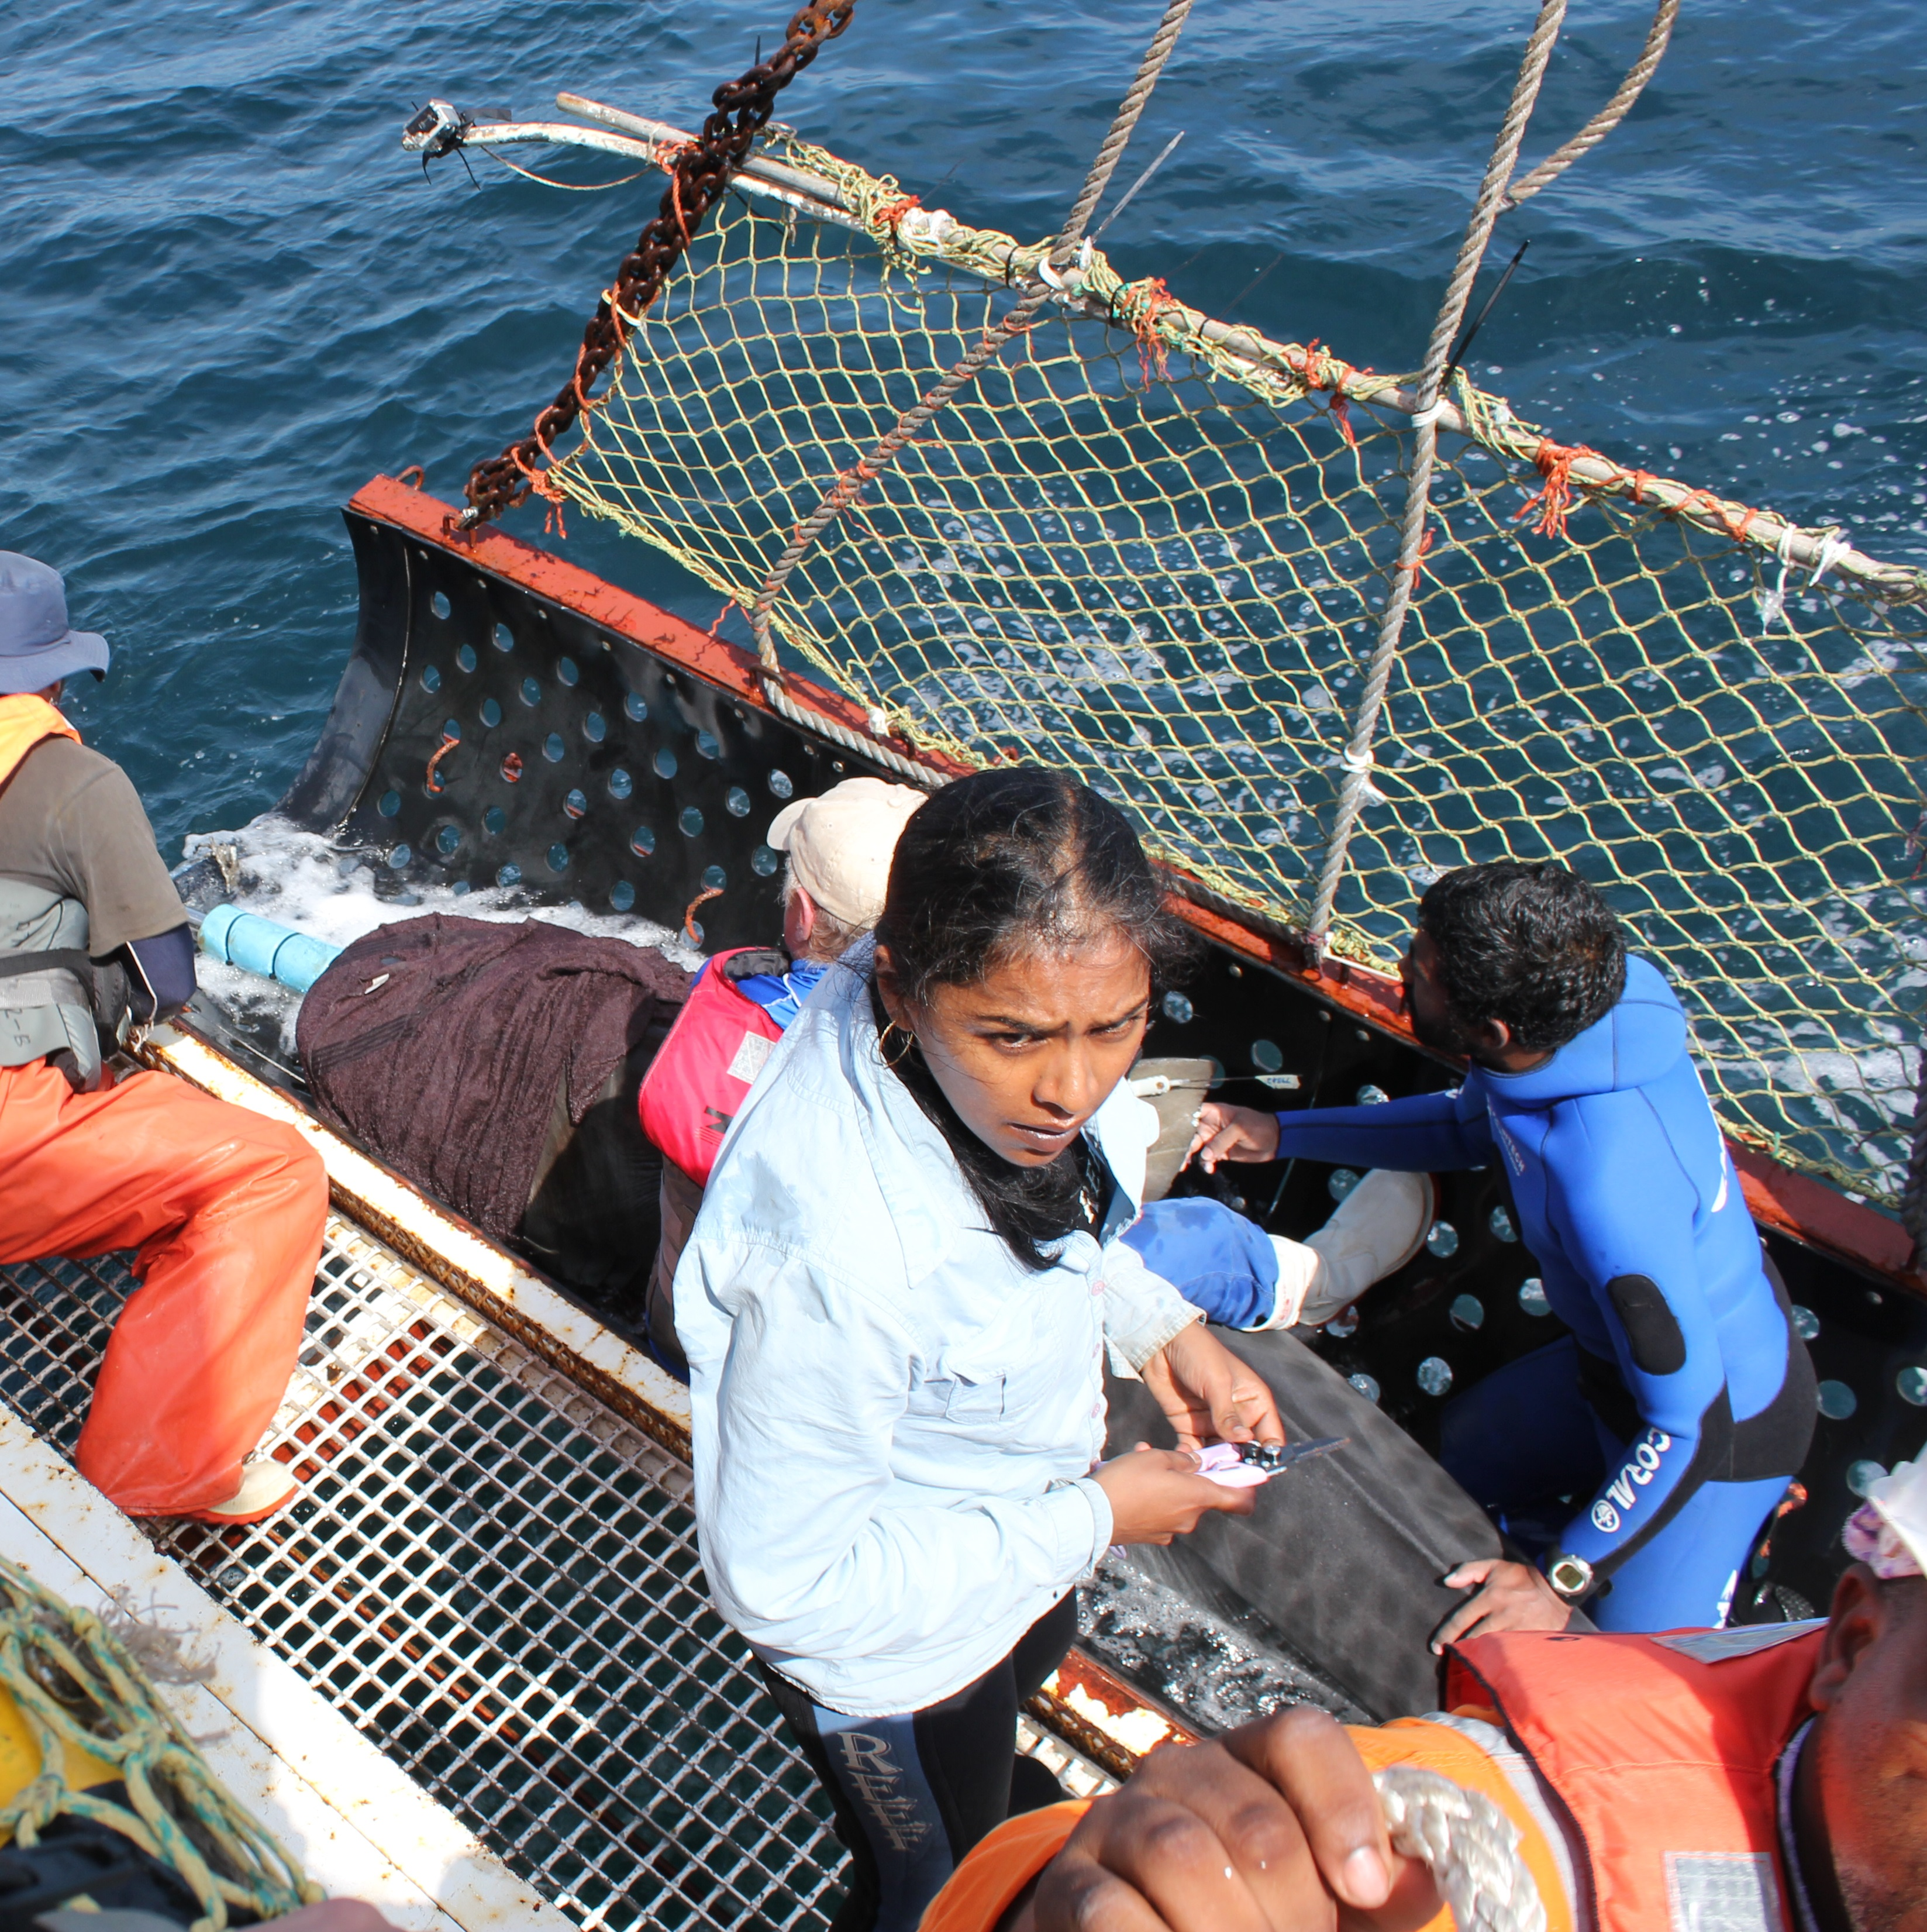
Conclusion
Diverse stakeholder issues require diverse approaches
Focus on Integration, coordination and communication
Strengthen link between science and management
Modernize methods of monitoring and data collection
Coordinate and facilitate research
Coordination and Communication is one of the key recommendations from the Panel!
Notes:
In Addressing aspects of conflict the department works in a consultative manner with all levels of government and depends heavily on stakeholder support
Avenues available to the public to contribute to decision making processes are now moving with the times and so are the platforms being developed for stakeholders to share and submit data
Coordination and communication is a key message that has been identified in successfully achieving the objectives outlined in the road map. And while this has always been a priority in the dept, There is always room for improvement
The OCIMS Project MIMS are respectively an initiative to have a range of data sources and information related to the marine environments Collated into a user friendly and easily accessible format
support a variety of oceans and coastal initiatives by providing information and decision support to key stakeholders for the day-to-day management of South Africa’s oceans and coasts.and Data

Slide 10
THANK YOU!
Sarika Singh
Expert Panel to review South Africa’s NPOA-Sharks
Oceans and Coasts: Research
Department of Environment, Forestry and Fisheries
Specific Acknowledgements:
Morne Hardenberg : Images
Mako Shark, Blue Shark, Great White Shark, Cow Shark, Tourism Sardine Run.

