Slide 1


Shark biodiversity in South Africa and assessment and planning to support spatial management
Kerry Sink
South African National Biodiversity Institute

Slide 2
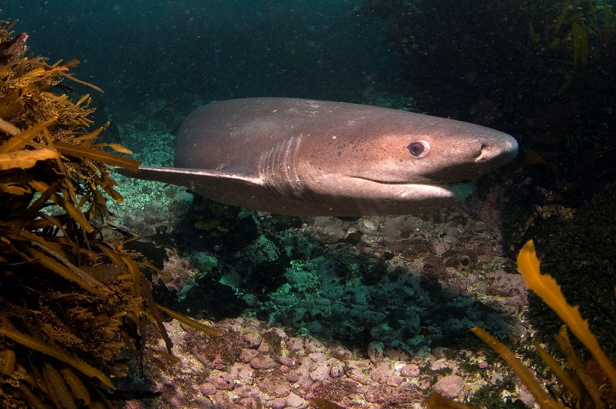
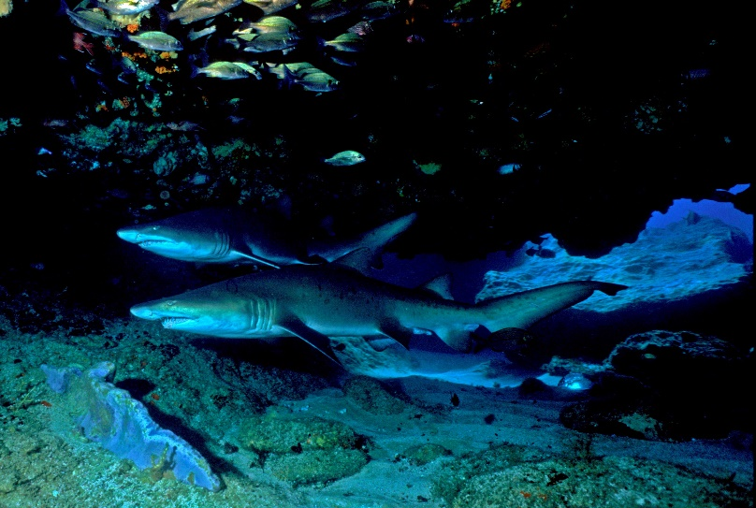
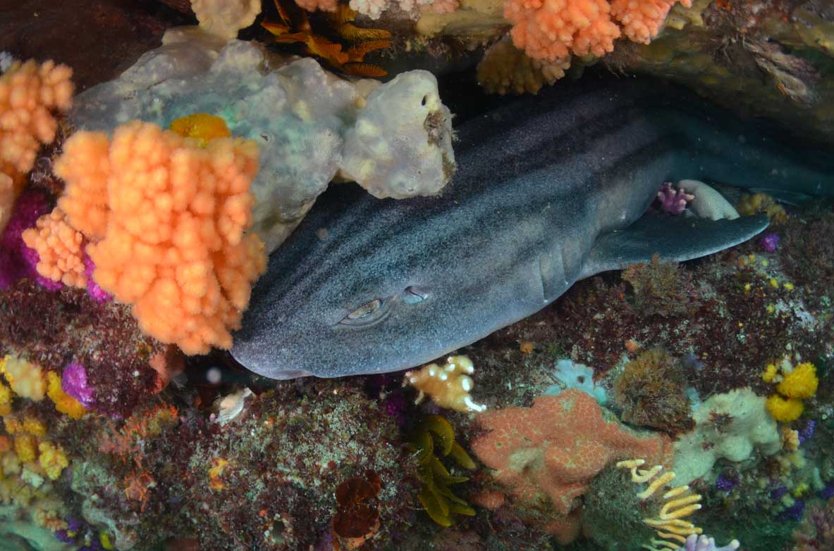
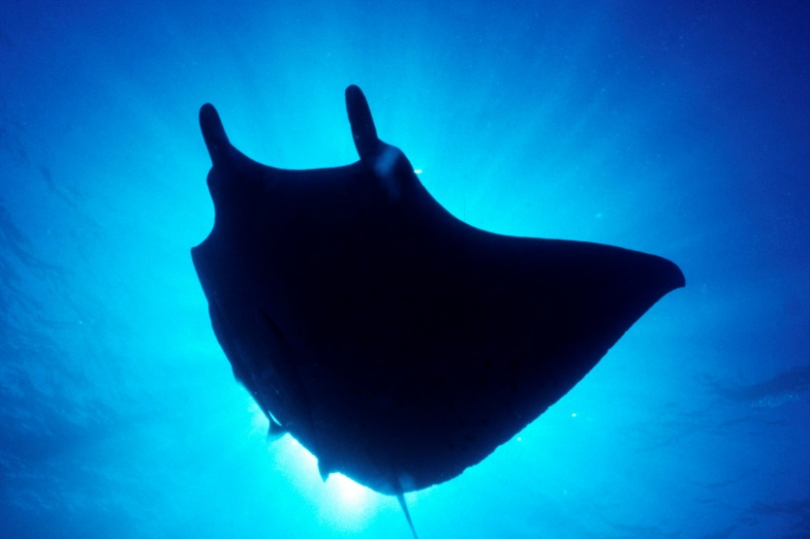
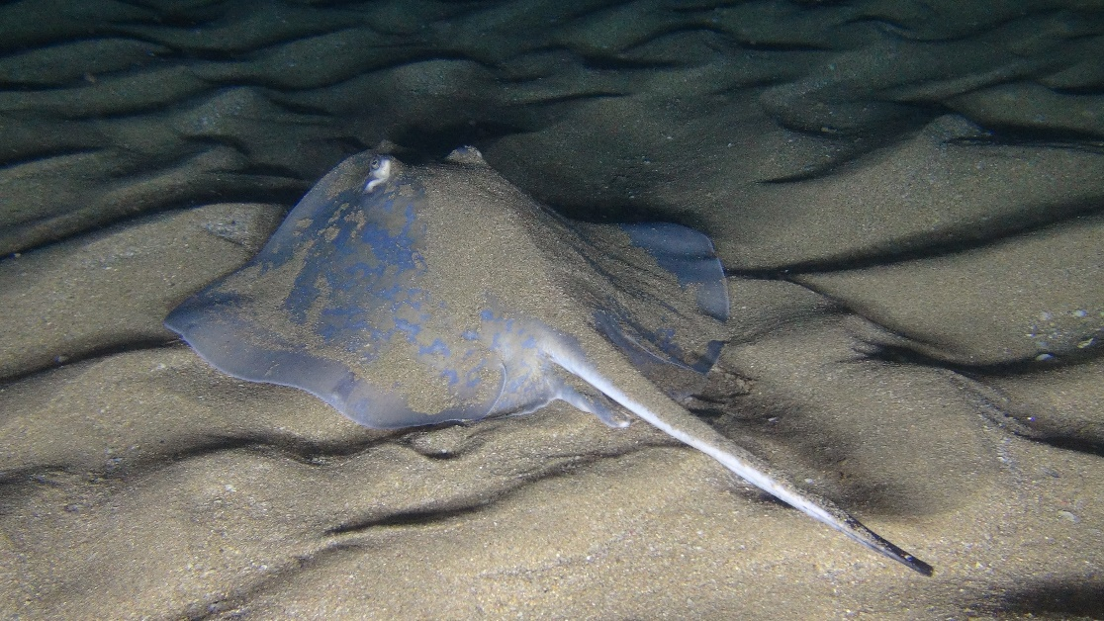
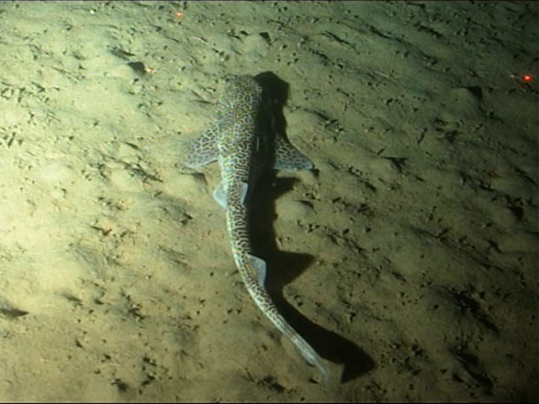
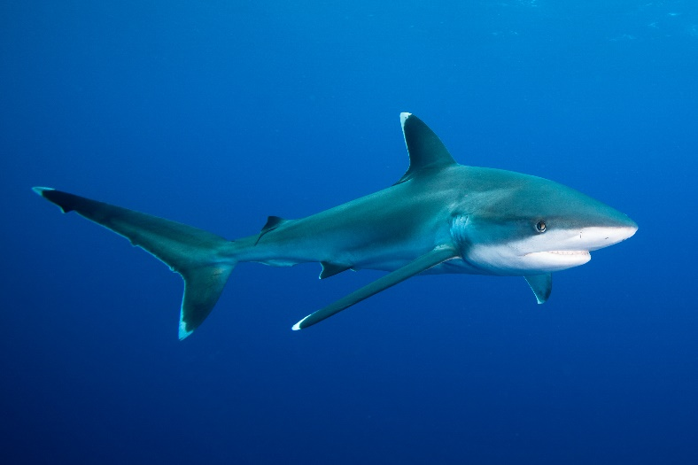
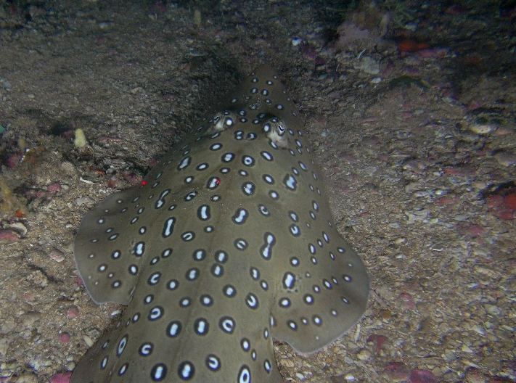
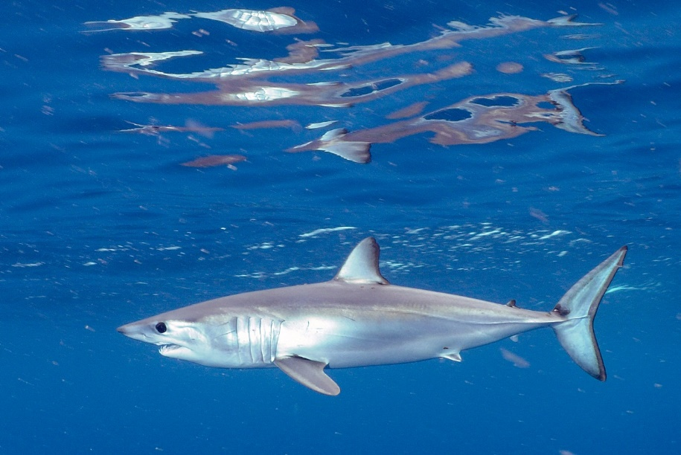
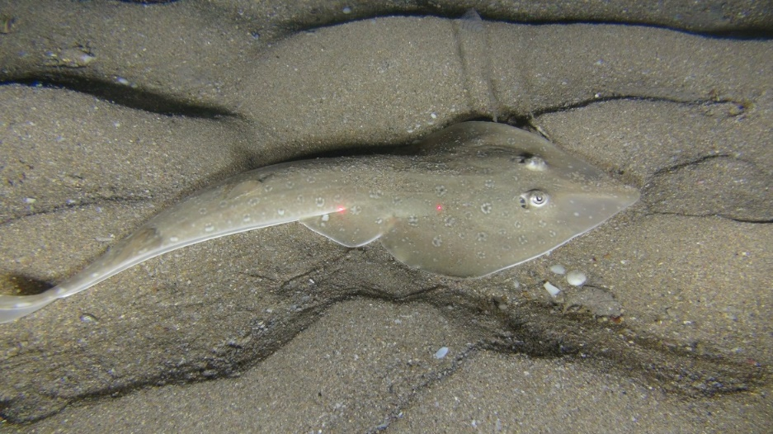
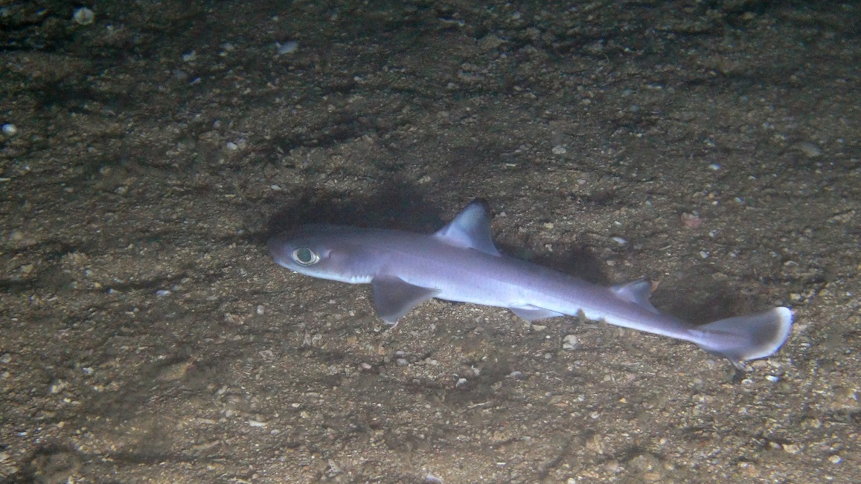
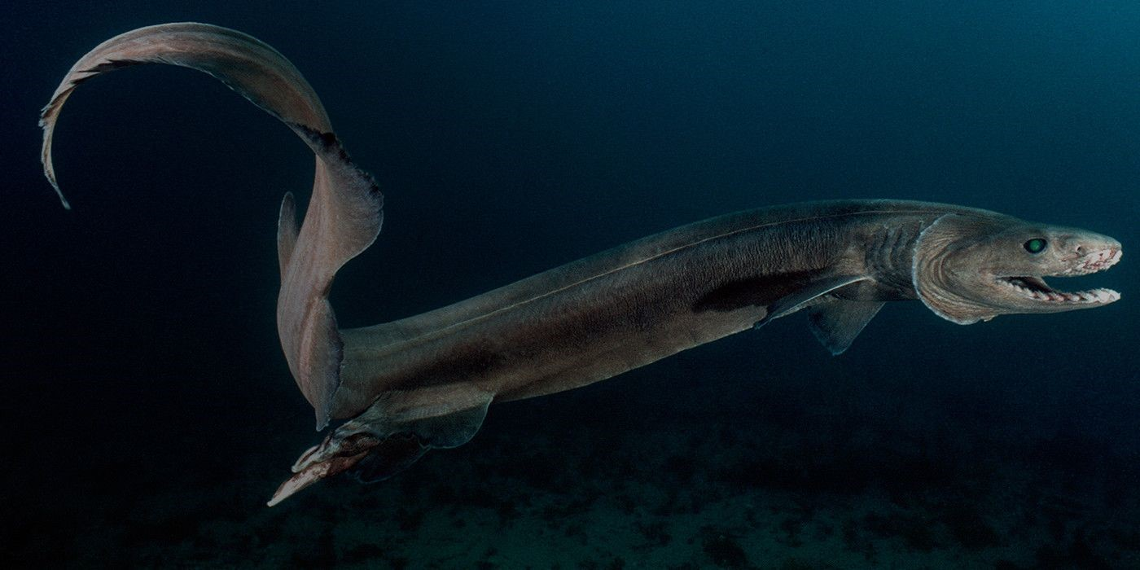
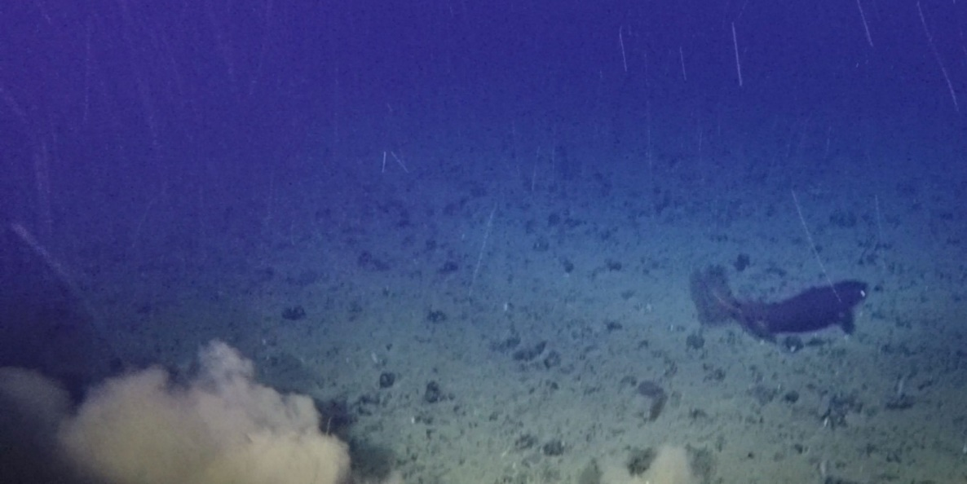
Kelp Forests
Photic Coral Reefs
Photic Rocky Reefs
Open Ocean
Deep Rocky Shelves
Canyons
Sandy Shelves
Seamounts
Muddy Shelves
Slopes
Abyssal plain

Slide 3
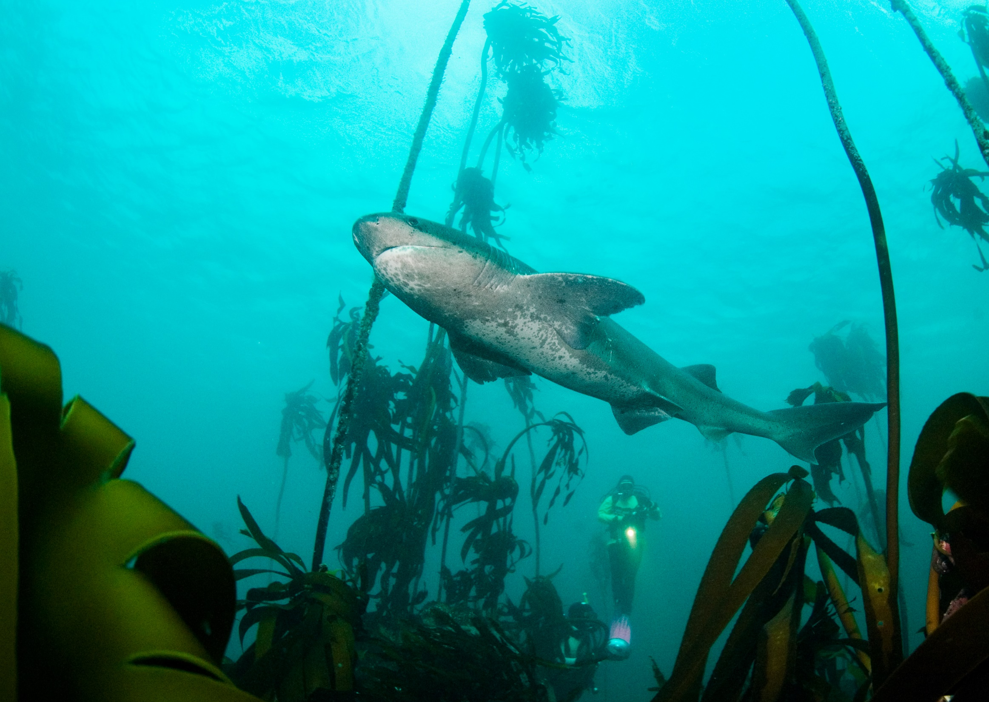
Benefits

Slide 4
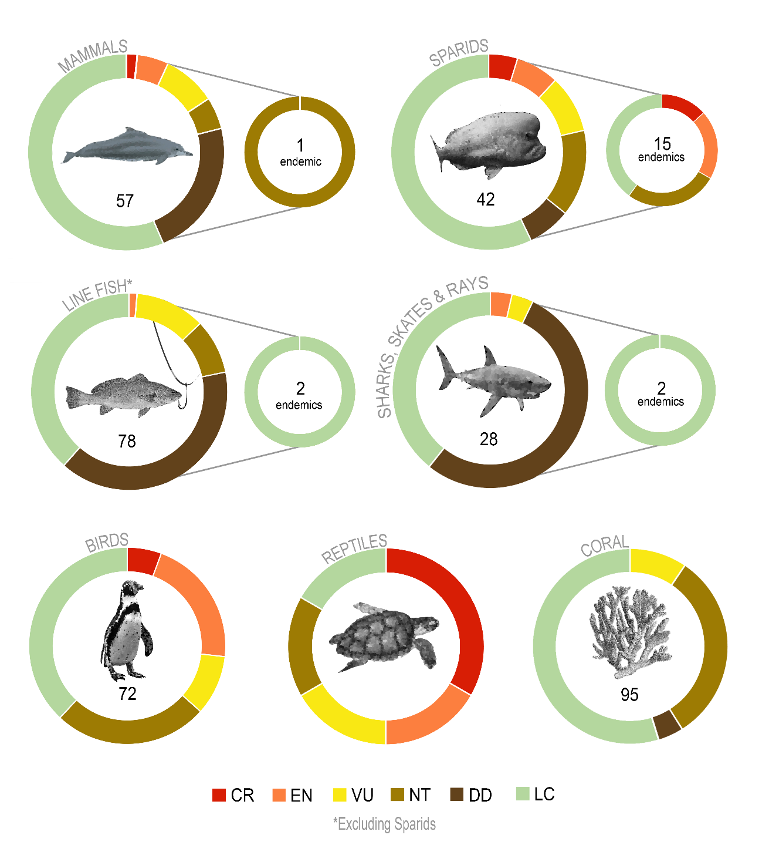
National Biodiversity Assessment
Stock status is known for less than 10% of harvested marine species: 39% are overfished
For redlisting, marine species have the highest levels of Data Deficiency across all realms
Despite limited effort in assessing the threat status of marine species in South Africa, 18% of the 378 species assessed using IUCN criteria are threatened
Marine species are threatened by fishing (especially poaching), alien species, pollution and climate change
Regional 2016
Global 2009, 2014
National 2015, 2018
National 2015, 2018
Regional 2015
Global and Regional 2008-2015
Global 2008
*Endemic= SA endemic

Slide 5
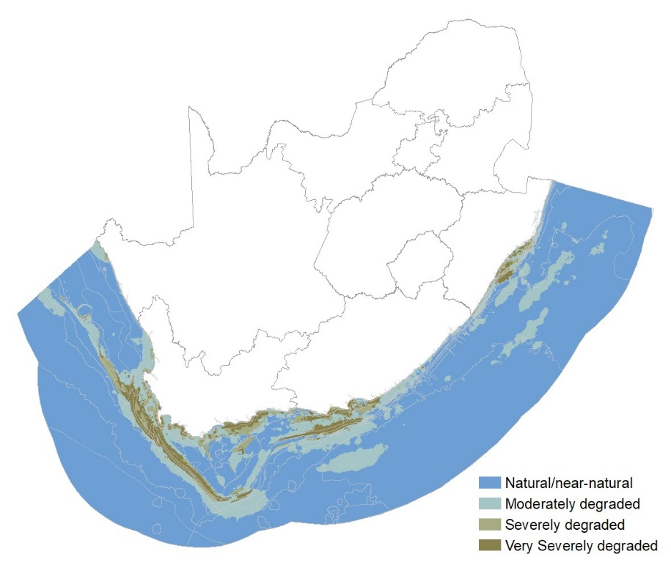
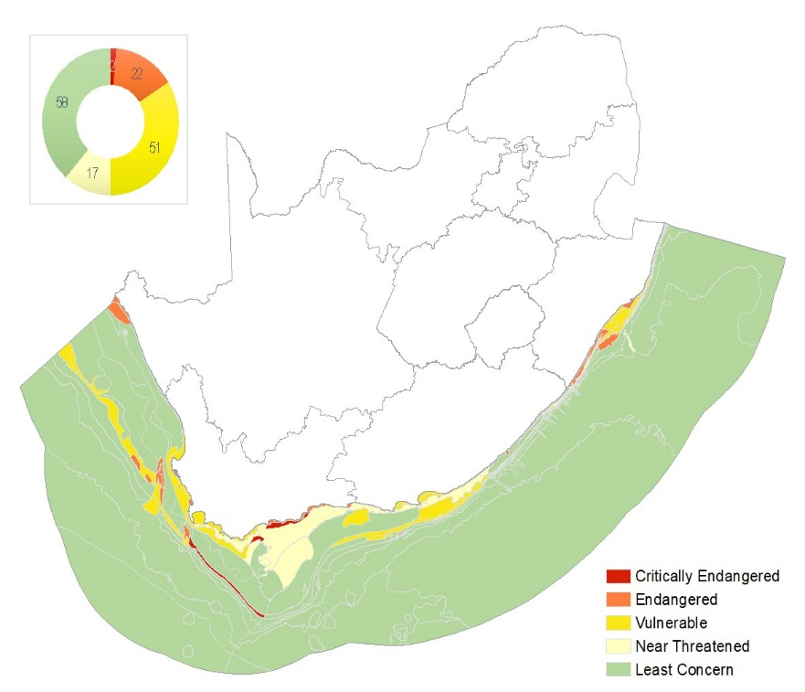
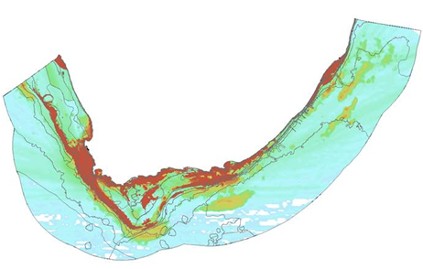
NBA Ecosystem Threat Status
The first assessment of marine ecosystems using IUCN Red List Criteria found that half of South Africa’s 150 marine ecosystem types are threatened
Map of 27 cumulative pressures
Ecosystem Condition

Slide 6
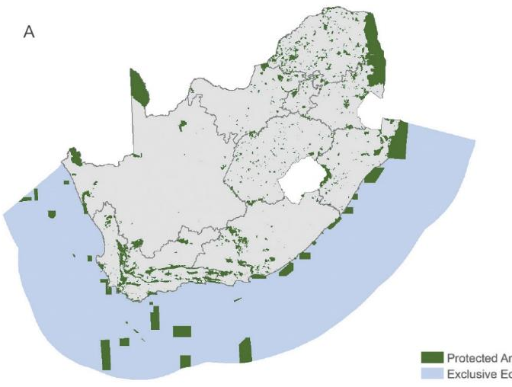
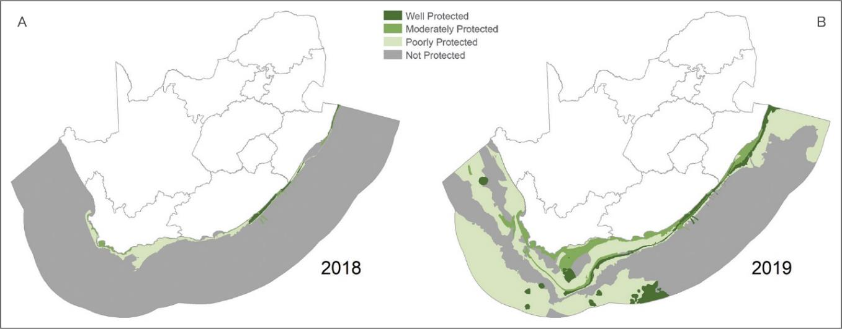
NBA Ecosystem Protection Level
2018 – 25 MPAs including Walker Bay & Prince Edward Island
2019 20 new MPAs proclaimed incl. expansions of existing MPAs, NOW South Africa has 42 MPAs
First protection for 51 ecosystem types
87% of the 150 marine ecosystem types now have some representation
5.4% protected
(57 900 km²)
Notes:
Slide 19. 2018 – 25 MPAs including Walker Bay & Prince Edward Island
Protection of our biodiversity really is one our success stories in South Africa;
The figure shows the dramatic improvement between 2018 and 2019 of marine ecosystem protection level. The result of the declaration of 20 new MPAs in our marine environment.
On land innovative biodiversity stewardship programmes have resulted in PA expansion that involves partnerships with landowners and communities. Building the platform for nature based tourism and the wildlife economy, and promoting protection and sustainable use of biodiversity.

Slide 7
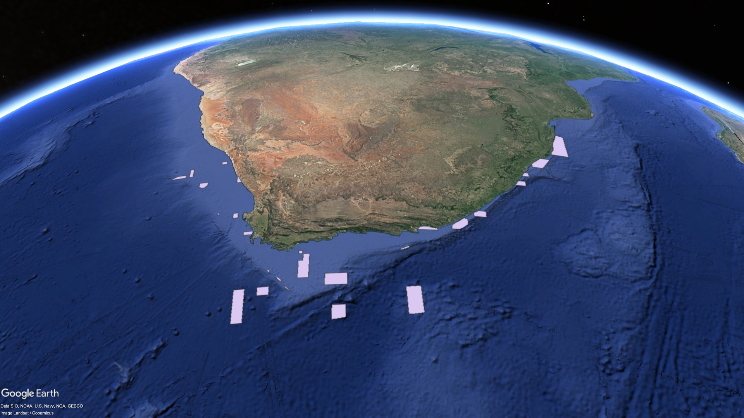
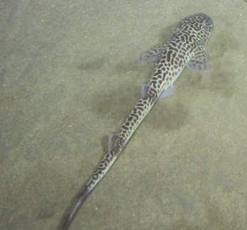
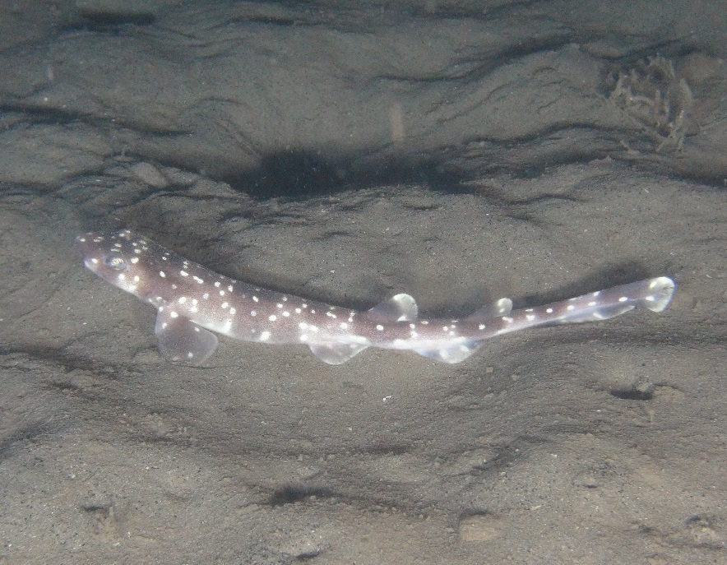
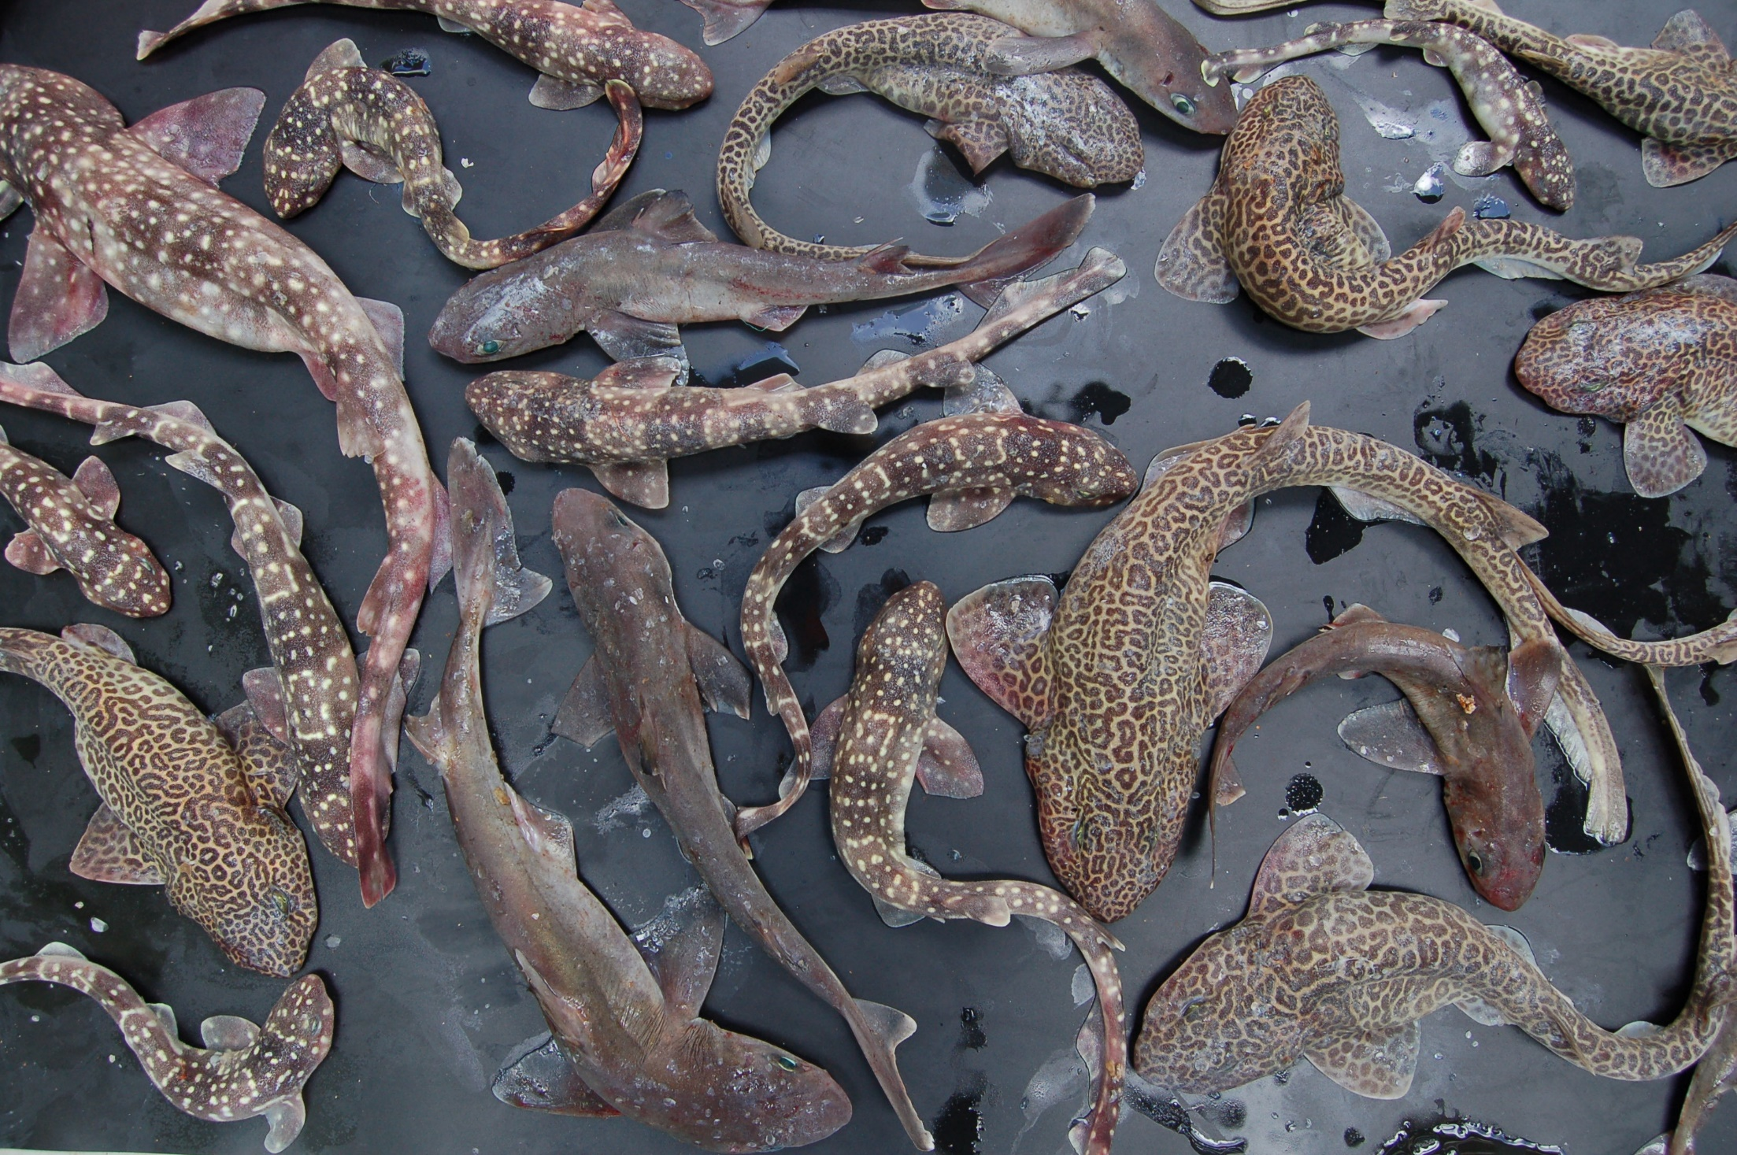
1. Orange Shelf Edge
1900 km²
"ORANGE REFUGE"

Slide 8
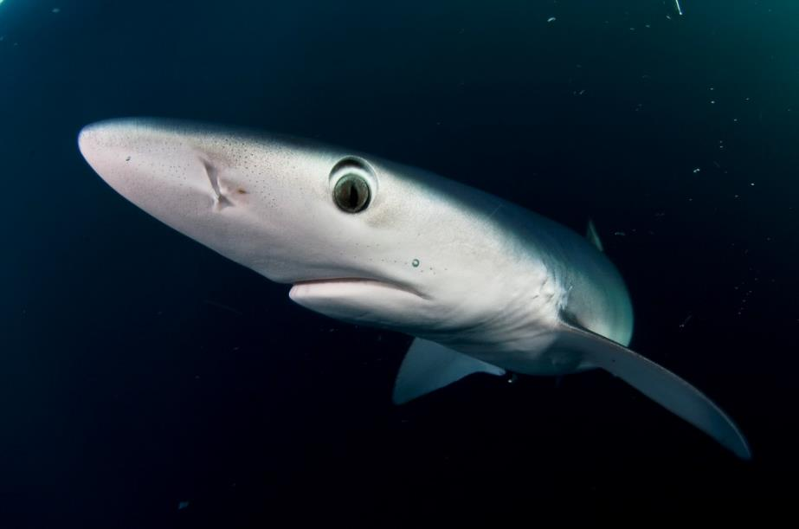
Steve Benjamin

Slide 9
10. Agulhas Bank Complex
"PRECIOUS PINNACLES"
780 km²

Slide 10
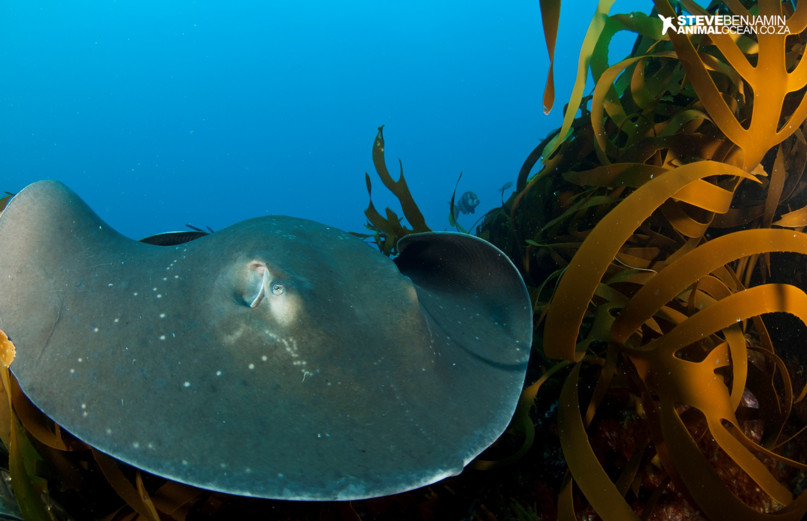
Steve Benjamin

Slide 11
12. Southwest Indian Seamounts
"CLIMATE REFUGE"
2 Areas covering 7500 km²
>200-5000 m (excludes 2000-3800m)

Slide 12
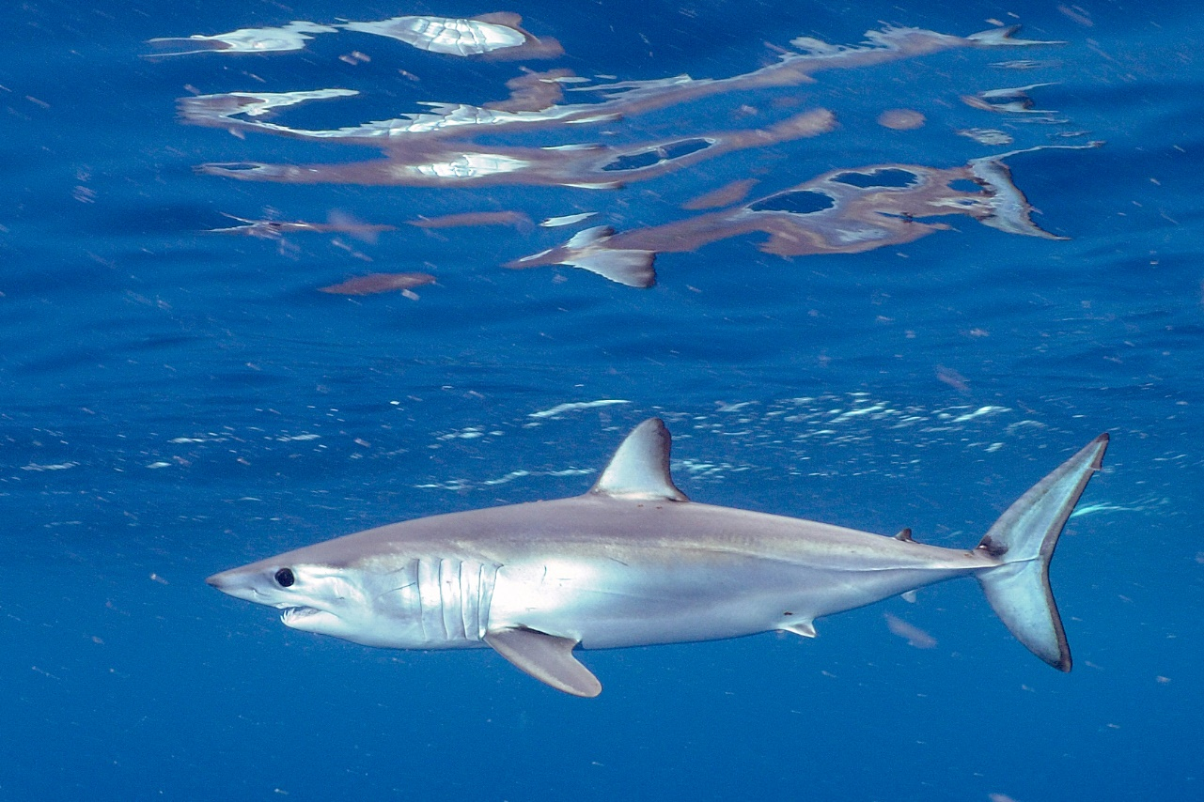
Steve Benjamin

Slide 13
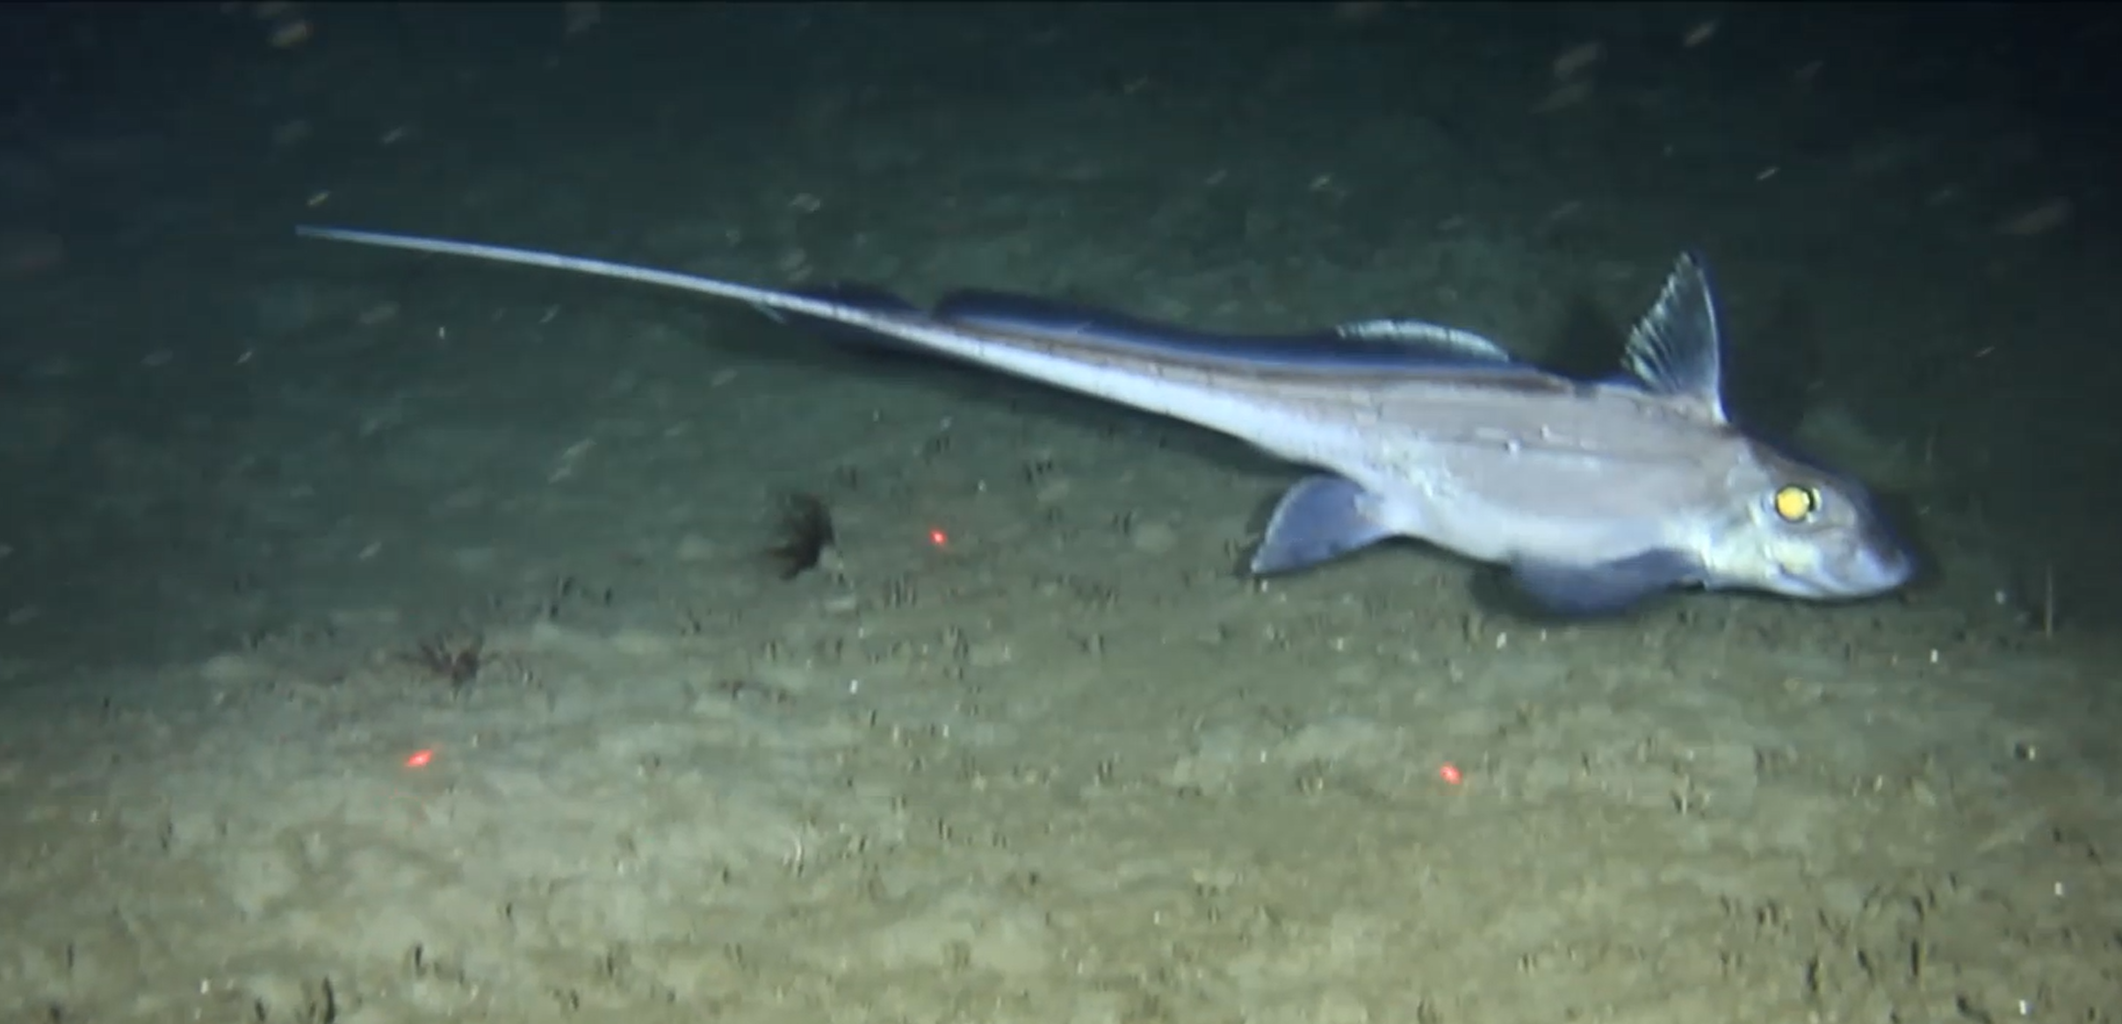
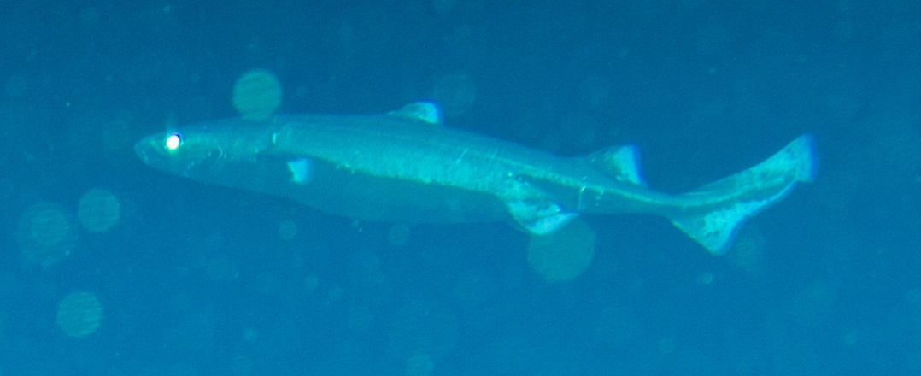
Port Elizabeth Corals
“Kingklip KINGDOM"
300- 800 m
220 km²
Centroscymnus owstonii (Vu)
626 m Kingklip Ridge
Chimaera notafricana 463 m

Slide 14
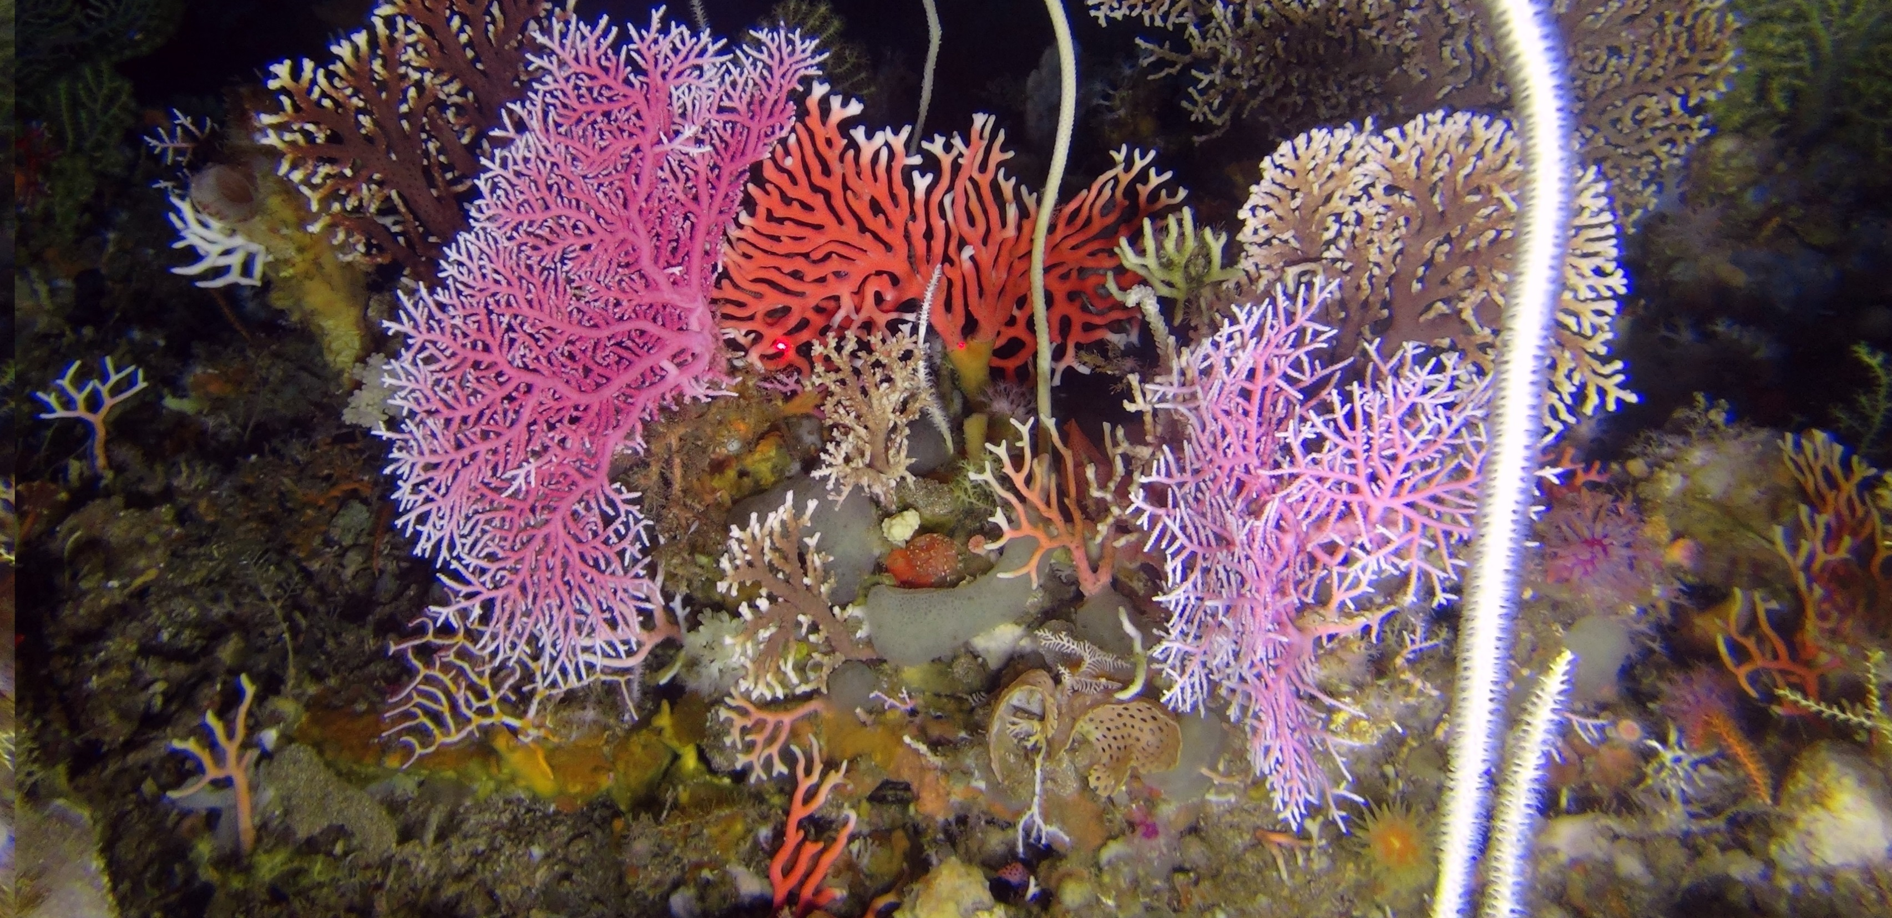
Amathole Offshore
“Lace Coral GarDENS"
40- 2200 m
400 km²

Slide 15
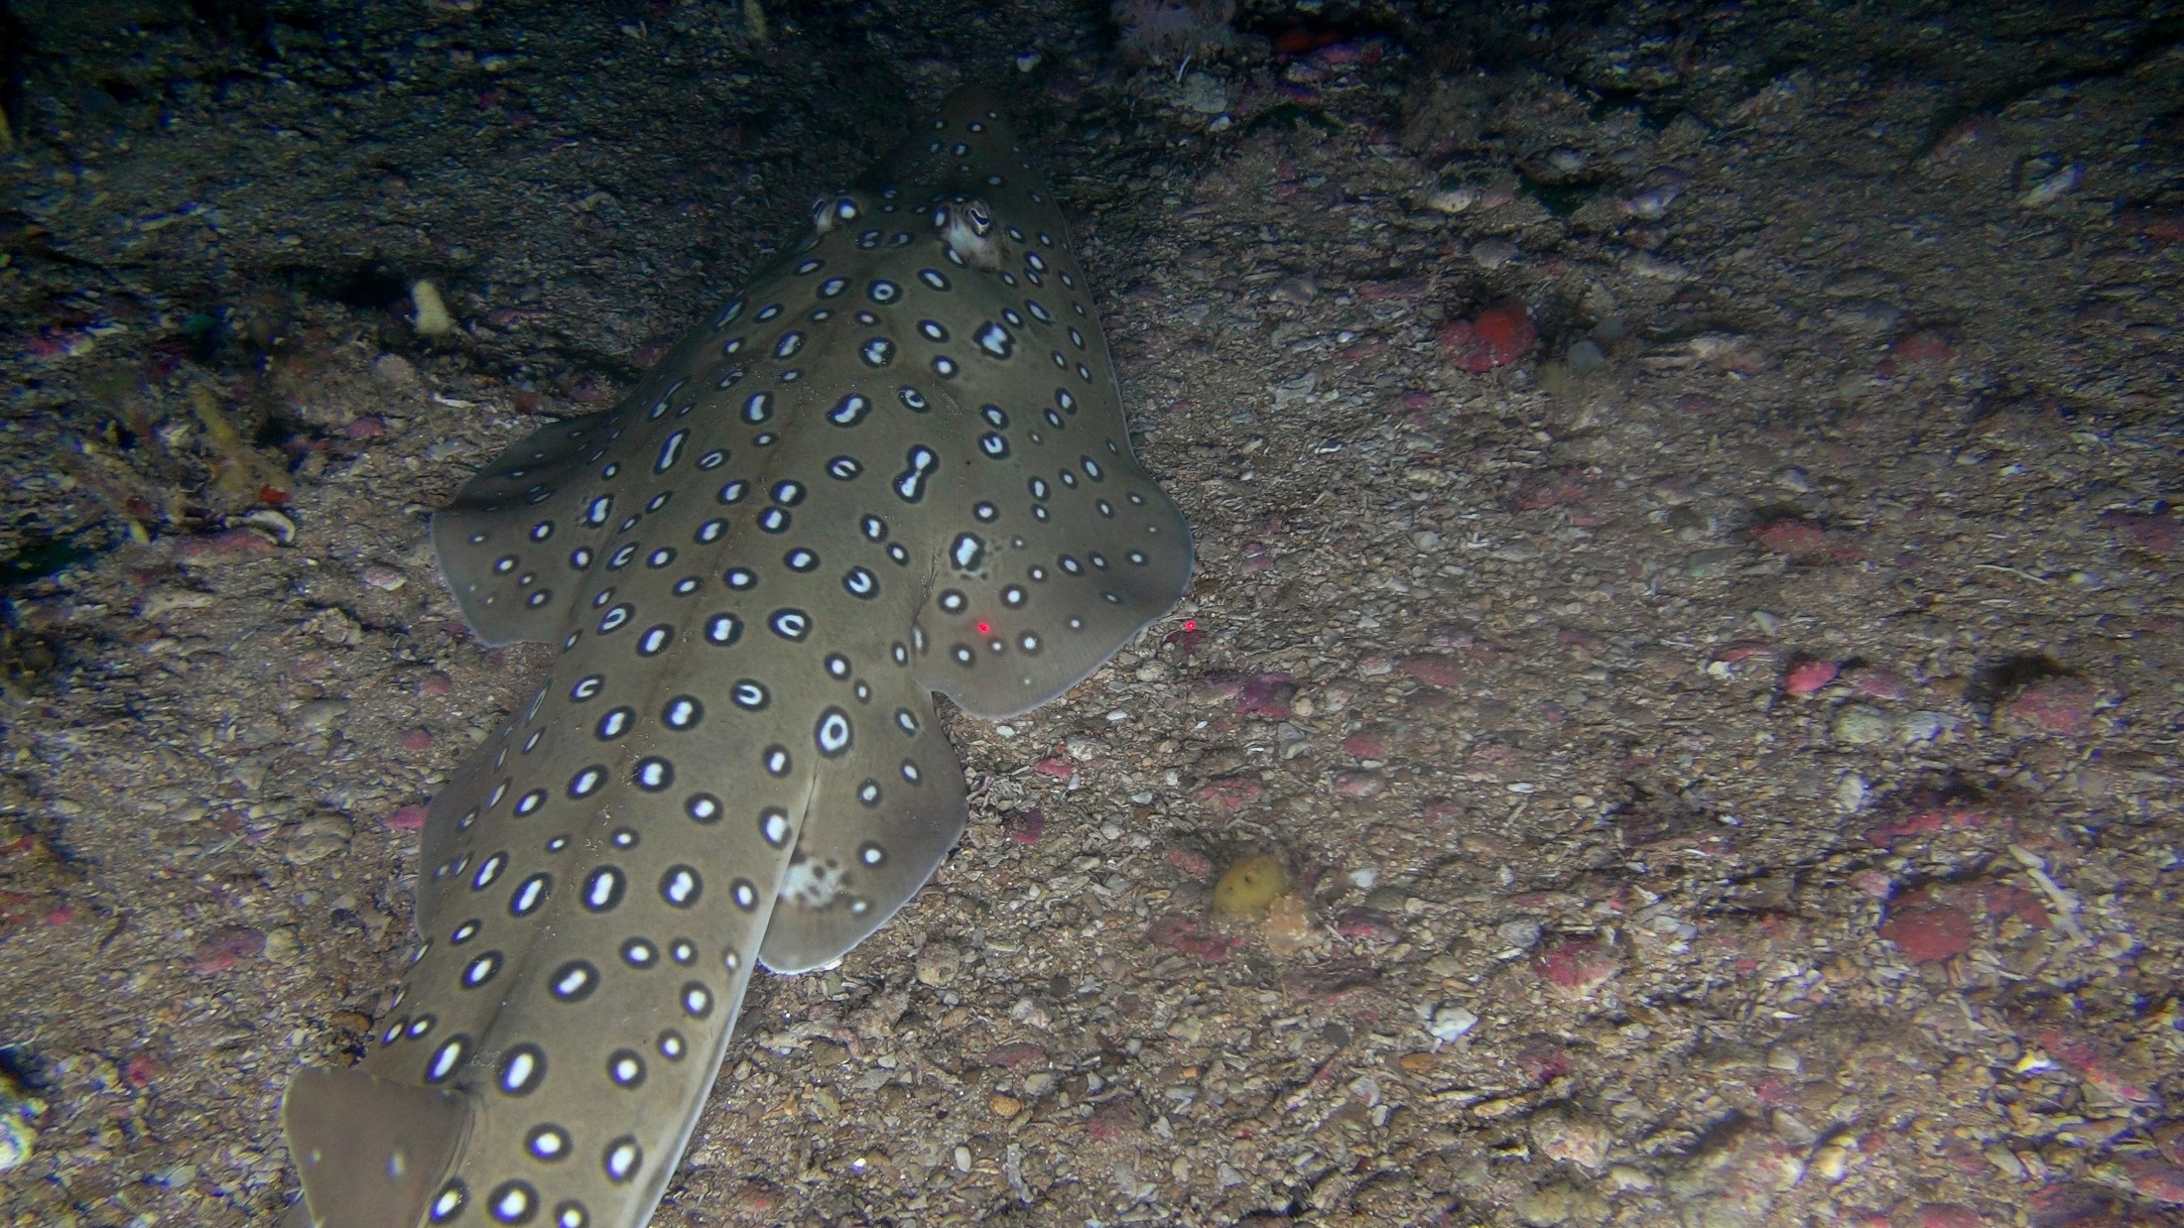
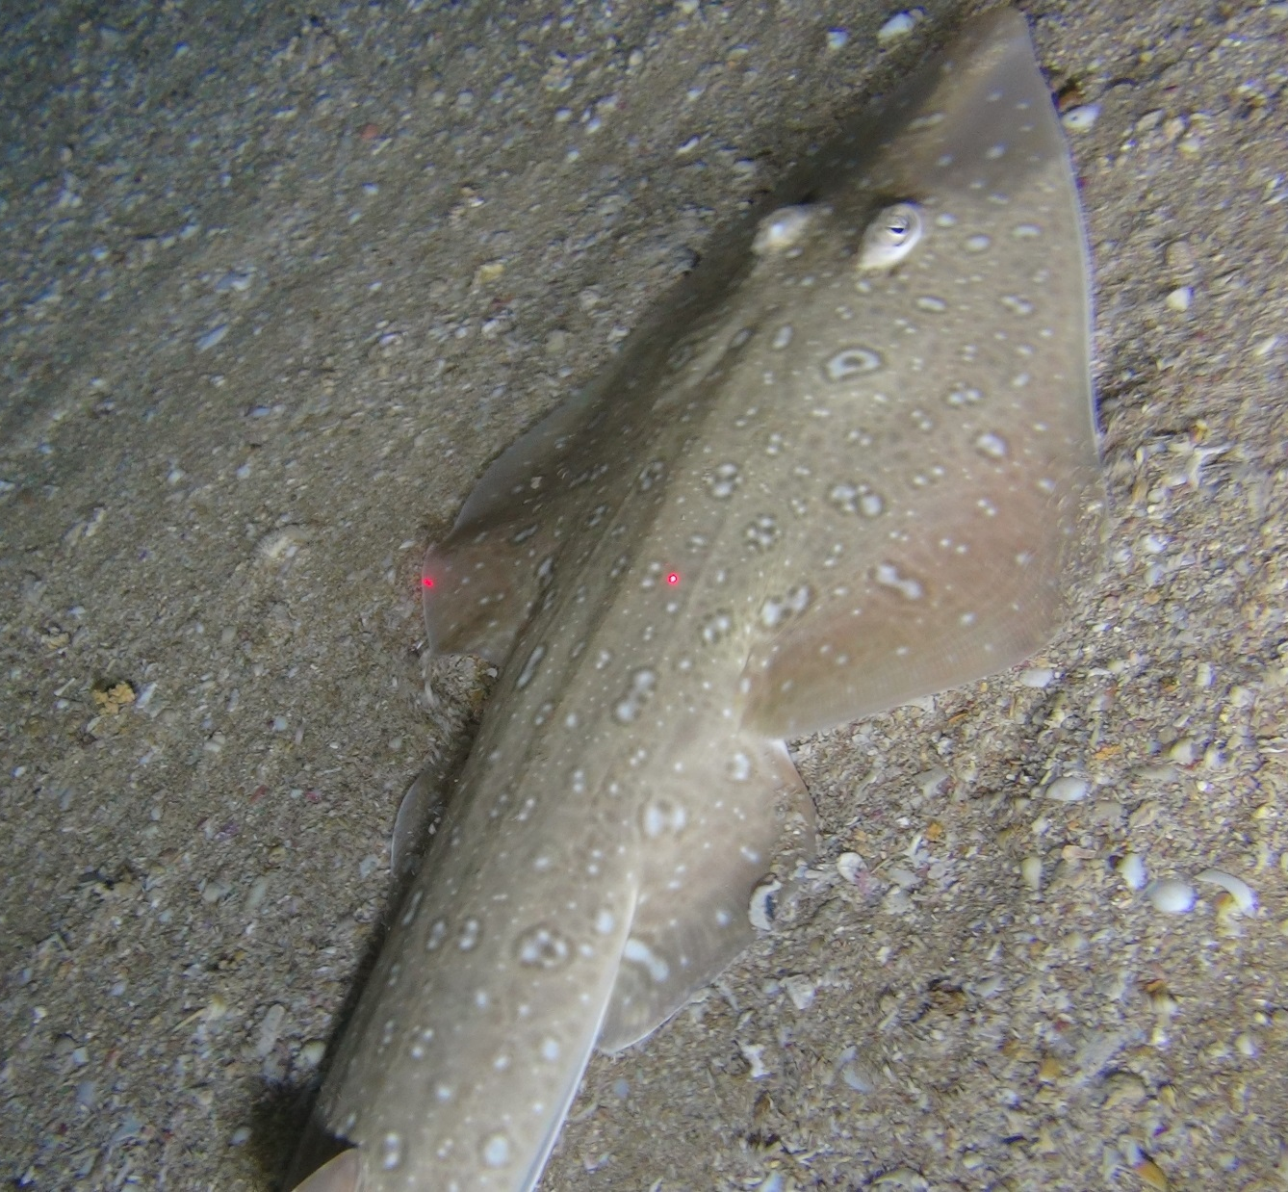
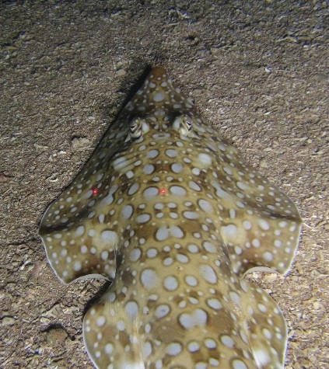
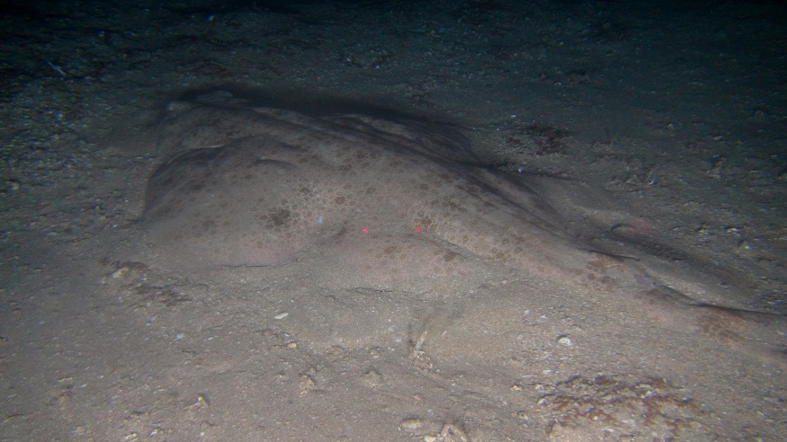
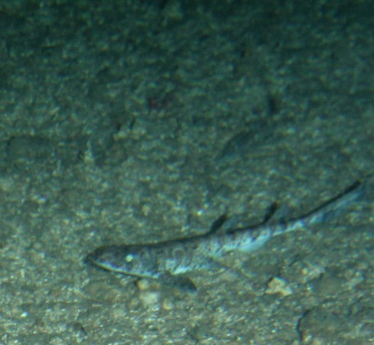
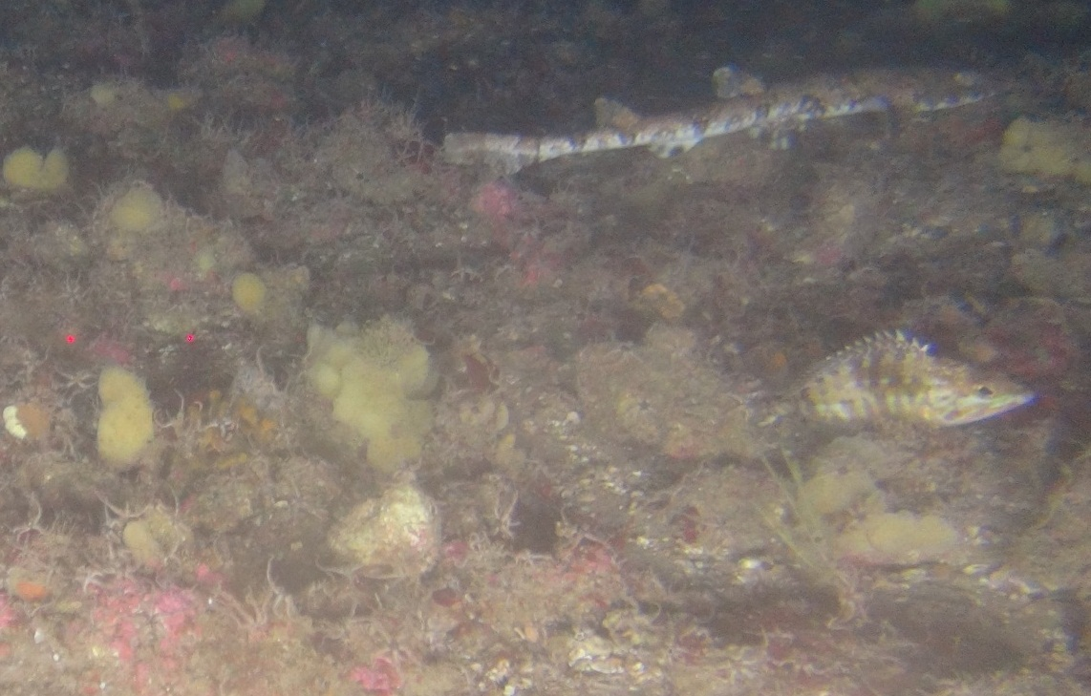
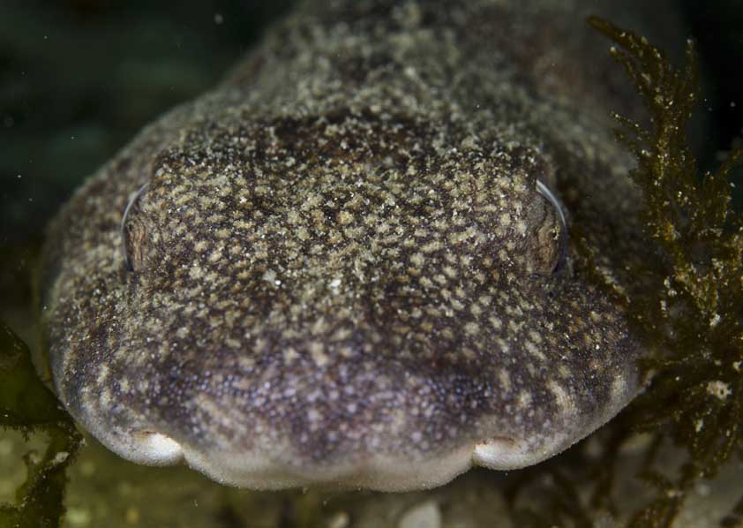
Imida r14 Kei 80m
Imida r21 91 goosens
ACEP Imida & ACEP Deep Secrets Projects

Slide 16
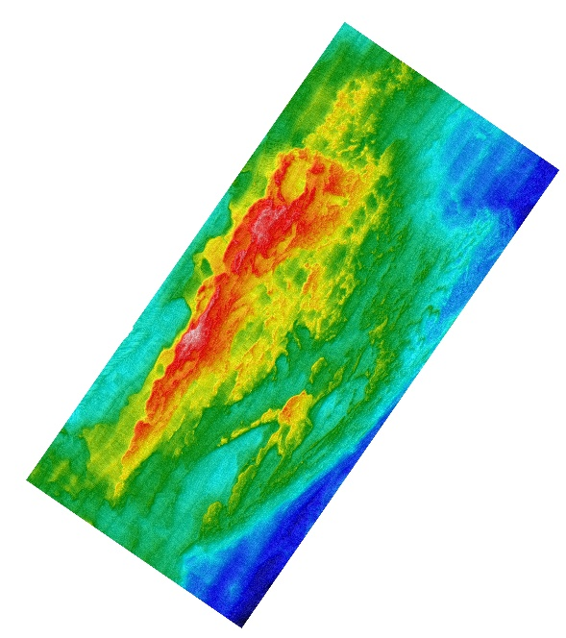
Protea Banks
"SHARK PARK"
40- 2000 m
1100 km²

Slide 17
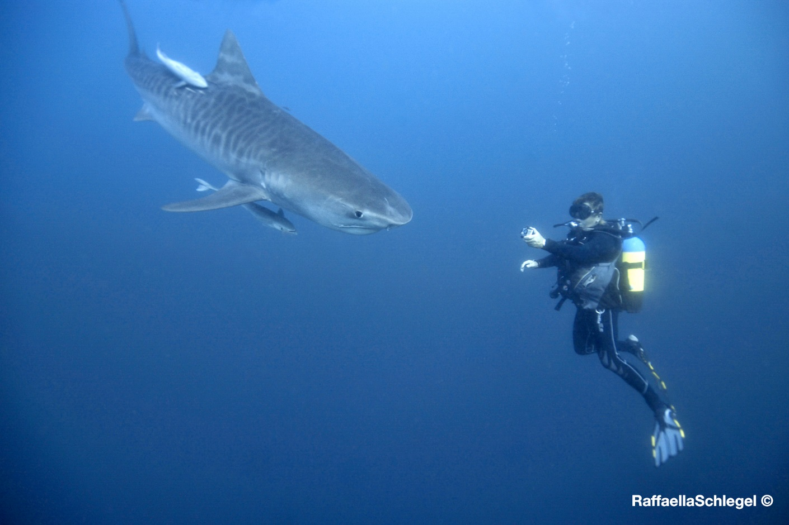
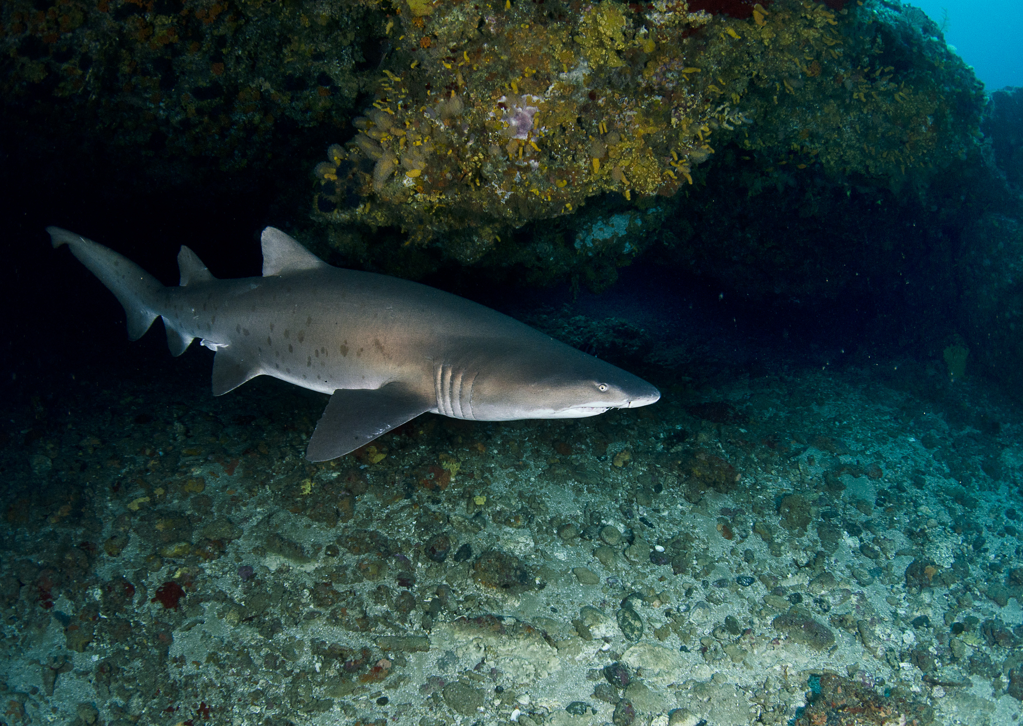
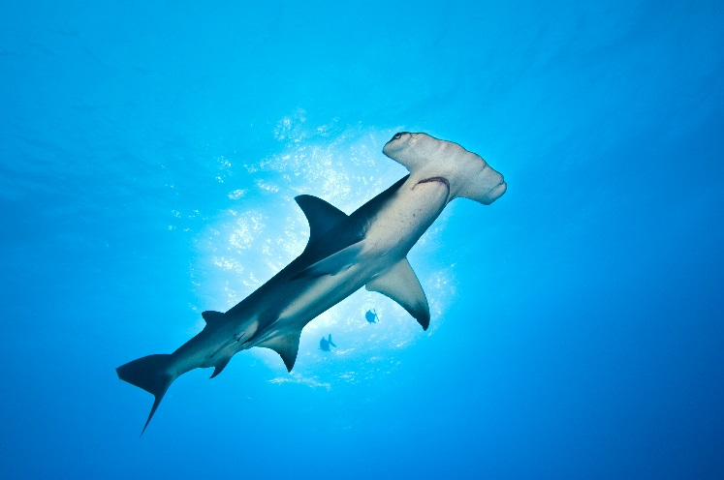
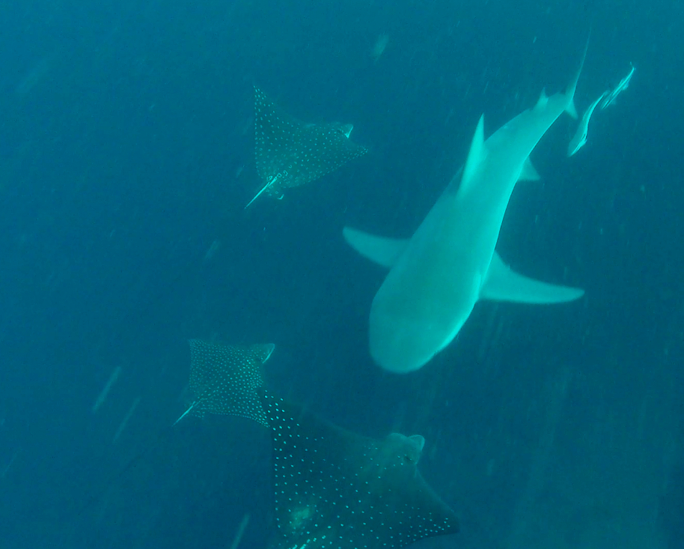
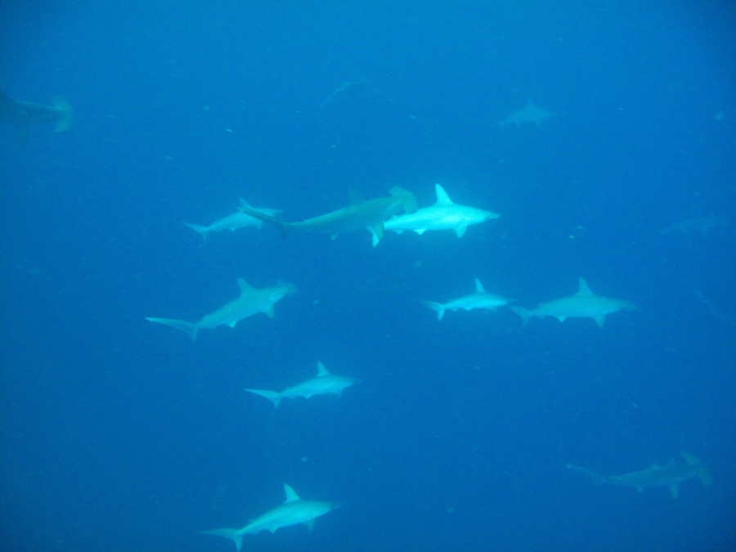
Ryan Daly, Geoff Spiby, African Dive Adventures

Slide 18
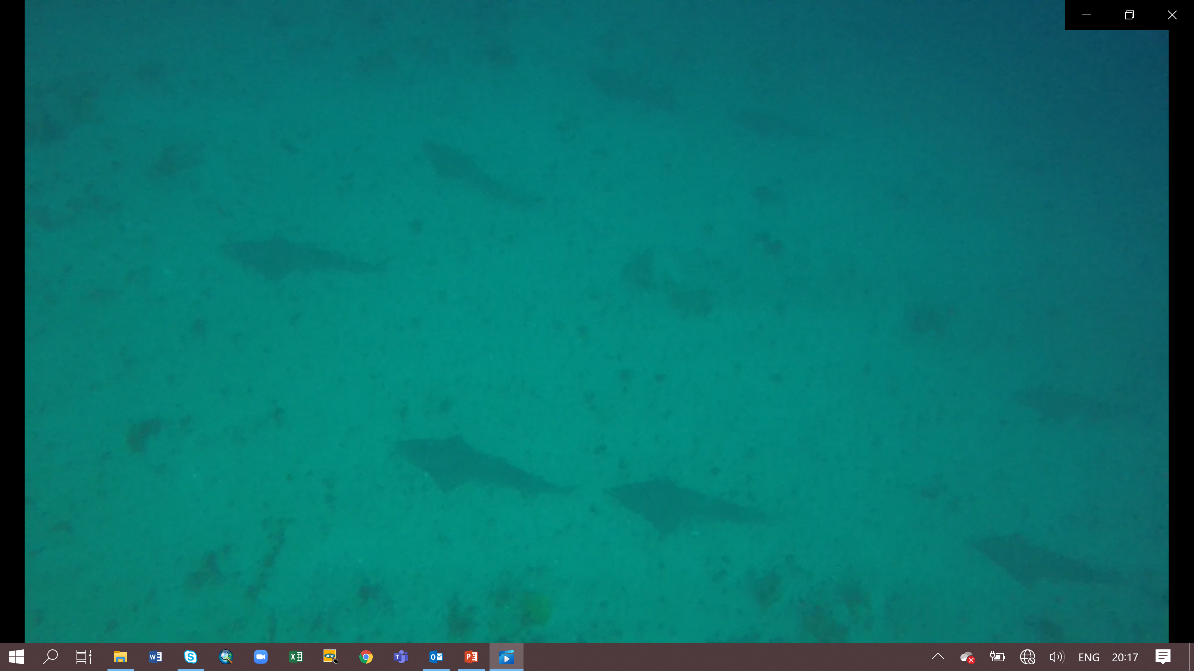
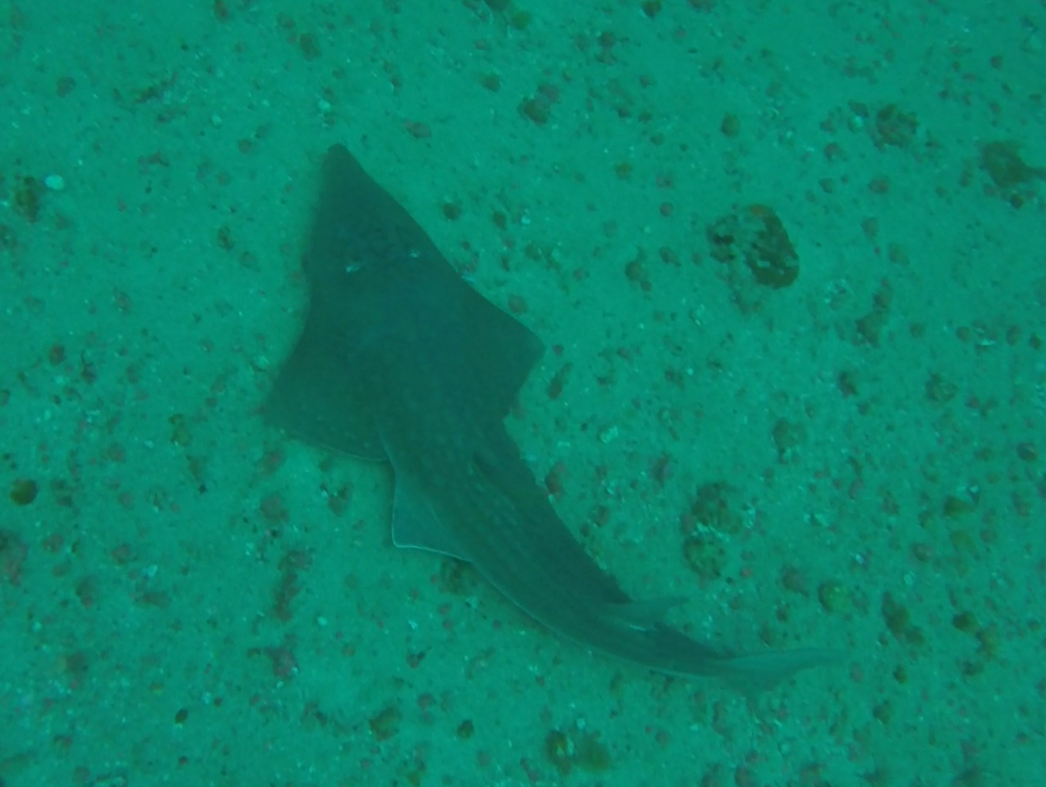
African Dive Adventures

Slide 19
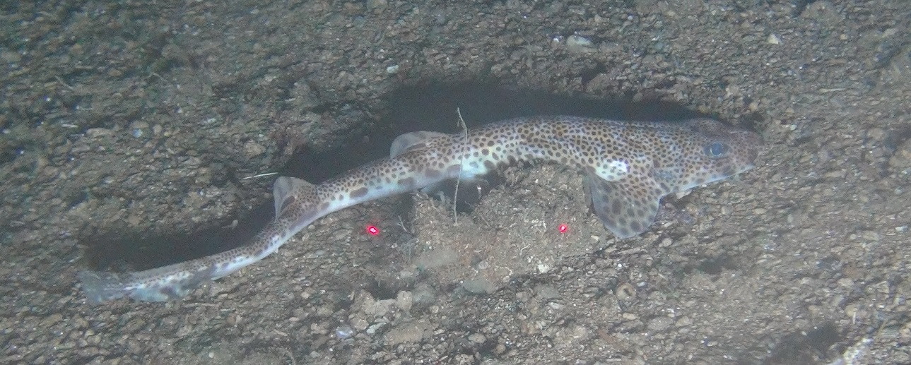
Aliwal Shoal & iSimangalio Expansion
uThukela MPA
Aliwal Shoal MPA Shelf Edge 240m
ACEP Spatial Solutions

Slide 20
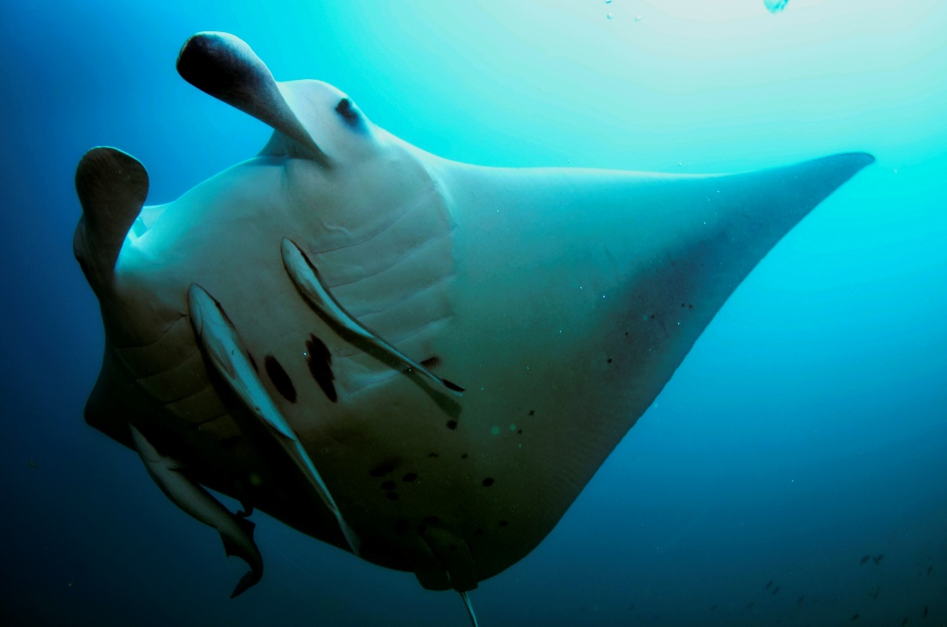
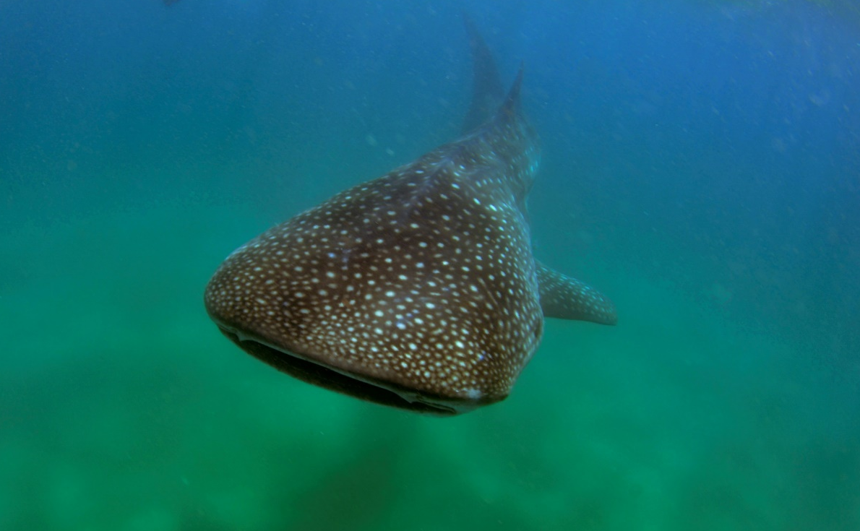

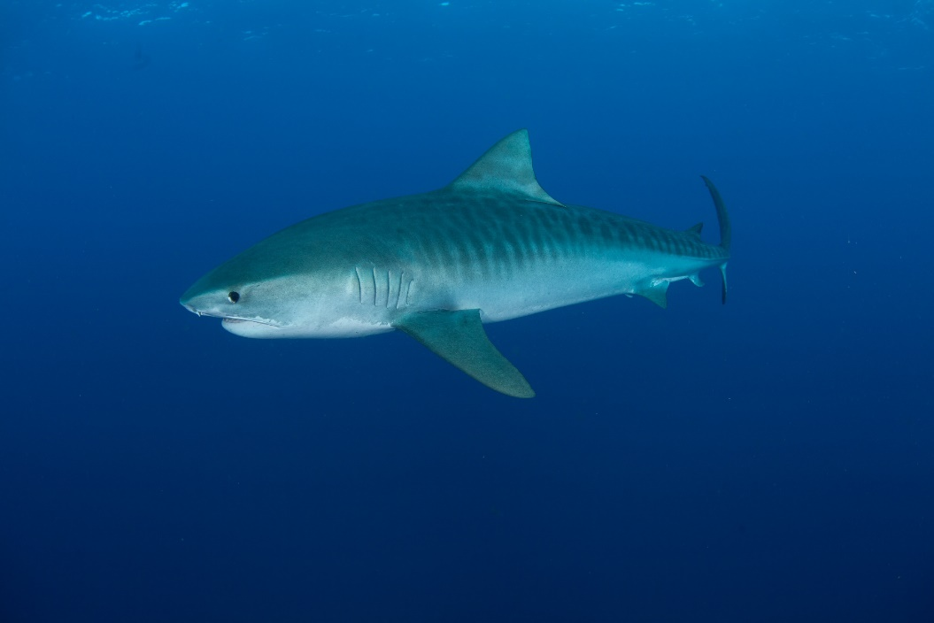
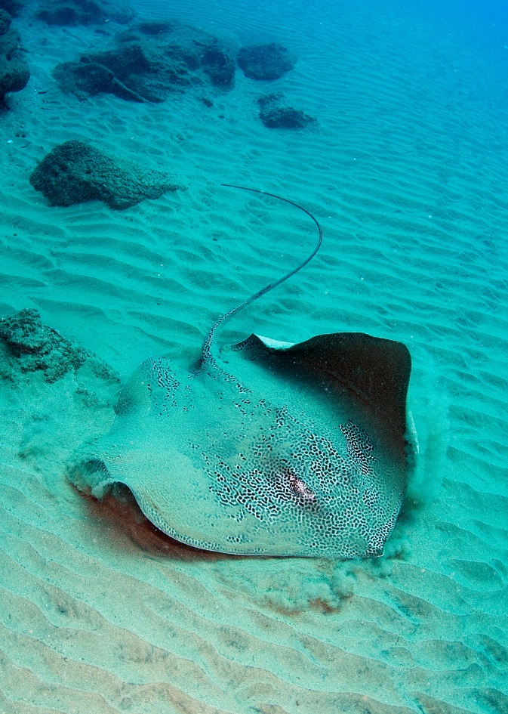




Eve Marshall
Ryan Daly
Geoff Spiby
ACEP

Slide 21

National Biodiversity Assessment Marine
Priority Actions
Modernise and integrate data collection, storage and access to improve marine assessment, analysis, monitoring, & to improve compliance with & evaluation of management actions.
Develop and implement effective fisheries management plans to secure food and job security & reduce ecosystem impacts of fisheries.
Enhance co-operative governance for improved, co-ordinated compliance & marine biodiversity management.
Effectively communicate the value of South Africa’s marine biodiversity through improved co-ordinated messaging that articulates benefits
Catalyse research to address critical knowledge gaps that limit the assessment of marine biodiversity & decision-making for a sustainable oceans economy.

Slide 22
Looking Ahead
Priority Action: Apply the Coastal and Marine Critical Biodiversity Area Map in Marine Spatial Planning and Environmental Impact Assessments to mitigate pressures in priority areas.
Strengthen the knowledge base for spatial assessment & planning
Species data & Atlas initiatives
Important life history areas
Redlist assessments

Slide 23
Spatial planning and management
The success of Marine Protected Areas depends on stakeholder and community support. Although MPAs are established by law and informed by research, ultimately it is the human dimensions of MPAs that shape their design, impact and effectiveness.
South Africa’s history has imposed additional challenges in stakeholder engagement, conservation efforts and spatial development that need to recognised and addressed.
Innovation is needed to advance focussed engagement with coastal communities and to better consider social and economic aspects in MPA design. This includes traditional fisher communities, small and large scale commercial fishers, recreational fishers, coastal land-owners and other stakeholders to adequately consider resource use, perspectives and values throughout such processes.
Well designed, transparent, inclusive and co-ordinated stakeholder processes with engagement from the outset are recommended to support the design and implementation of spatial management measures including Marine Spatial Planning, MPA expansion and Other Effective Conservation Measures (OECMs).

Slide 24

THANK YOU!
Prof Kerrry Sink
On behalf of the Shark Expert Panel as appointed by the Honourable Minister, Barbara Creecy
Principal Scientist and Marine Programme Manager
South African National Biodiversity Institute
Kirstenbosch
Cape Town
Research Associate
Nelson Mandela University
k.sink@sanbi.org.za
Tel: 021 7998855 | Mobile: 082 8310536

