Slide 1
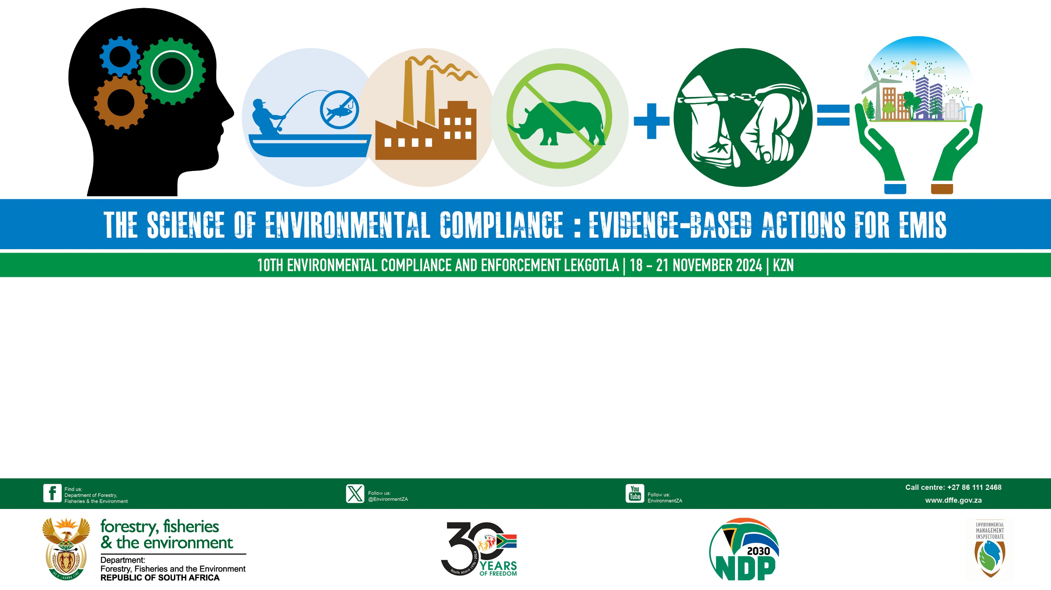
NATIONAL ENVIRONMENTAL CRIME FORUM
PHAKISA
INITIATIVE 5 - Enhanced and Coordinated Enforcement Programme

Slide 2
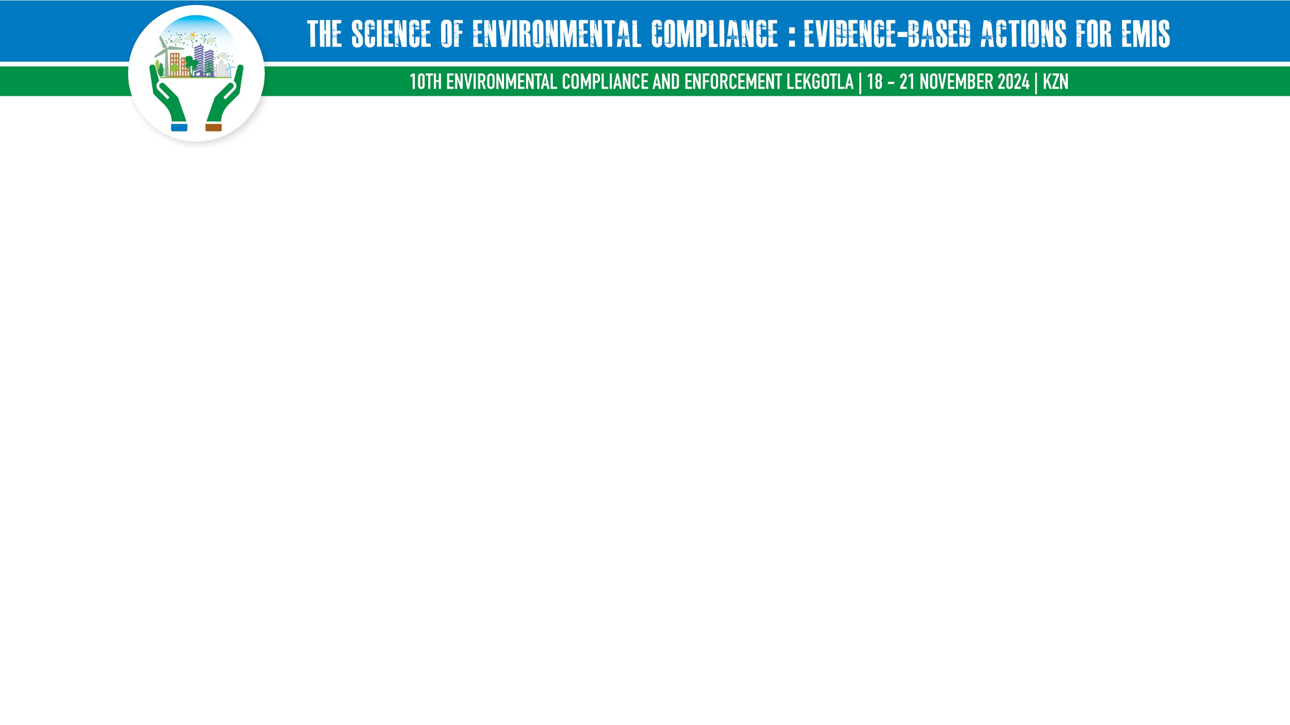
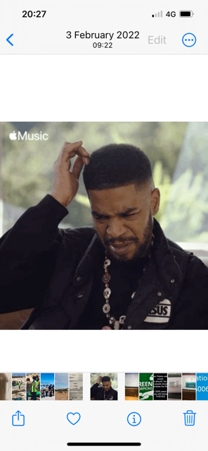
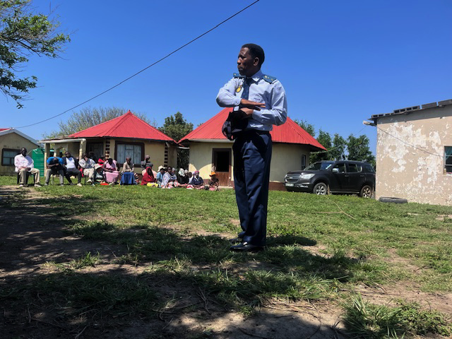
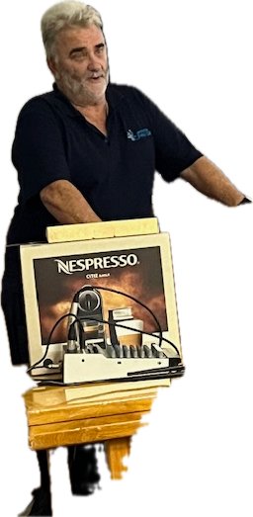
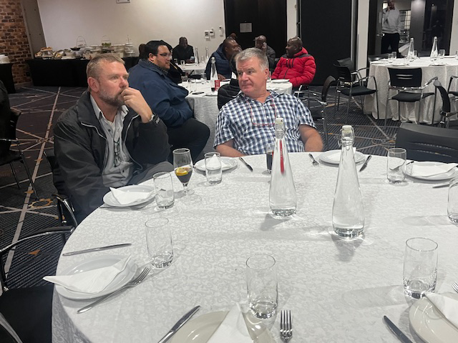
PHAKISA?
Others say it’s “PHANGISA”
Some say it’s
“PIKISA”
🌹MY WIFE🌹 SAYS IT’S
PAKISHA –
MEANING: PACKING BAGS TO LEAVE HOME ALWAYS
WHAT?????
PUKUSHA??
NEE MY BROER
DO YOU KNOW PHAKISA?

Slide 3

INTRODUCTION
“PHAKISA” – A SISOTHO NAME MEANING - ‘MAKE FAST OR HURRY UP ’
Presidential Initiative
Unlocking the Potential of South Africa’s Oceans - implement an integrated ocean governance framework for sustainable growth of the ocean economy to maximise socio-economic benefits whilst ensuring adequate ocean environmental protection
Five areas of focus in relation to Oceans Economy namely and fifth one was added:
    Offshore Oil and Gas Exploration
    Marine Transport and Manufacturing
    Aquaculture
    Marine Protection Services and Governance
    Small Craft Harbours and Coastal Development and Tourism

Slide 4
MARINE PROTECTION SERVICES AND GOVERNANCE: INITIATIVES
Ministerial Committee and Secretariat to Govern Activities
Enhancement of Legislation into the Integrated Coastal and Oceans Management Act or Oceans Act
Review of ocean-related legislation
Accelerated Capacity Building Intervention in Ocean Governance
Enhanced and Coordinated Enforcement Programme
National Ocean and Coastal Information System and Extending Earth Observation Capacity
National Ocean and Coastal Water Quality Monitoring Programme
Creation of a Marine Protected Area Representative Network
Marine Protected Area / Marine Spatial Planning Discovery, Research & Monitoring Programme
Marine Spatial Planning Process

Slide 5
ENHANCED AND COORDINATED ENFORCEMENT PROGRAMME
Operation Phakisa Initiative 5 is aimed at securing the South African coast and waters, through an integrated multidimensional approach to ensure the environment is conducive for the development of the ocean economy and economic security of the maritime zones, main drivers being:
Co-ordination required for enforcement and policing of coasts and oceans (integrated operational approach)
Need to improve monitoring, control and surveillance (domain awareness)
Identification and protection of sensitive and unique marine habitats and species
Limited human and financial resources to manage ocean resources and environment – need to join forces and leverage resources
Need to address the high level of Illegal, Unregulated Fishing Activities (IUU) in addition to the other illegal activities (integrated operational approach)

Slide 6


















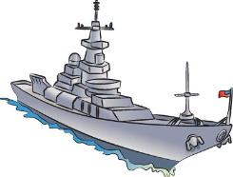
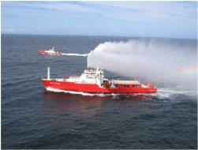

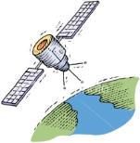
Initiative 5
Enhanced and Coordinated Enforcement Programme
NOT EXHAUSTIVE
Collaborated & Shared Assets
This will support the existing Security Cluster Programme so that Security Assessments and Management Plans can be developed.

Slide 7
WORK PLAN 2024/2025
ENHANCED AND COORDINATED COMPLIANCE AND ENFORCEMENT PROGRAMME
INITIATIVE 5
Goal: Protect and improve the quality and safety of the oceans and coastal environment through collaborated and coordinated
compliance and enforcement interventions
MARINE PROTECTION SERVICES AND GOVERNANCE

Slide 8

ANNUAL TARGETS
ACTIVITIES | ANNUAL TARGET
National Meetings | 4x CEWG Meetings – 1 meeting per quarter 11x IOSTT Meetings – 1x in-person meeting per quarter 2x virtual meetings
Provincial meetings | 16x Planning meetings – Joint operational planning meetings
Operations | 32x Joint operations – 8x Operations per quarter

Slide 9
DEPARTMENTS/INSTITUTIONS PARTICIPATED IN INTERGRATED OPERATIONS
DEAPRTMENTS | NUMBER OF PARTICIPANTS
SAPS | 542
DFFE (FISHERIES) | 484
DMRE | 8
EC- DEDEAT | 6
SANPARKS | 2
Dept. Home Affairs | 6
SARS (customs) | 6
SANDF | 0
KZN - EDTEA | 0
SSA | 2
Ethekwini Municipality | 0
Road Traffic Inspectors KZN | 0

Slide 10
DEPARTMENTS/INSTITUTIONS PARTICIPATED IN INTERGRATED OPERATIONS
DEAPRTMENTS | NUMBER OF PARTICIPANTS
Western Cape National Park | 24
CapeNature | 158
DAERL (Northern Cape) | 12
City of Cape Town (Law Enforcement) | 134
Overberg Law Enforcement | 334
DEADP (Western Cape) | 8
Dark Waters Ops | 4
Boarder Management Authority | 2
Transnet | 2
TOTAL | 1736

Slide 11
JOINT OPERATIONS PLANNED AND EXECUTED
WESTERN CAPE | EASTERN CAPE | KWAZULU-NATAL | NORTHERN CAPE
06 – 07 May 2024 | 08 May - 18 June 2024 | 17 May – 16 June 2024 | 17 – 21 April 2024
08 – 10 May 2024 | 17 – 27 August 2024 | 22 June – 17 July 2024 | 20 – 23 June 2024
11 – 28 May 2024 | 16 – 26 September 2024 | 27 July – 18 August 2024 | 26 – 30 August 2024
21 – 23 May 2024 |  | 27 Aug. – 28 September 2024 | 05 – 10 September 2024
21 – 22 September 2024 |  |  | 26 – 29 September 2024
TARGET | ACHIEVED
16x Joint Operations planned and executed | 17x Joint Operations executed

Slide 12
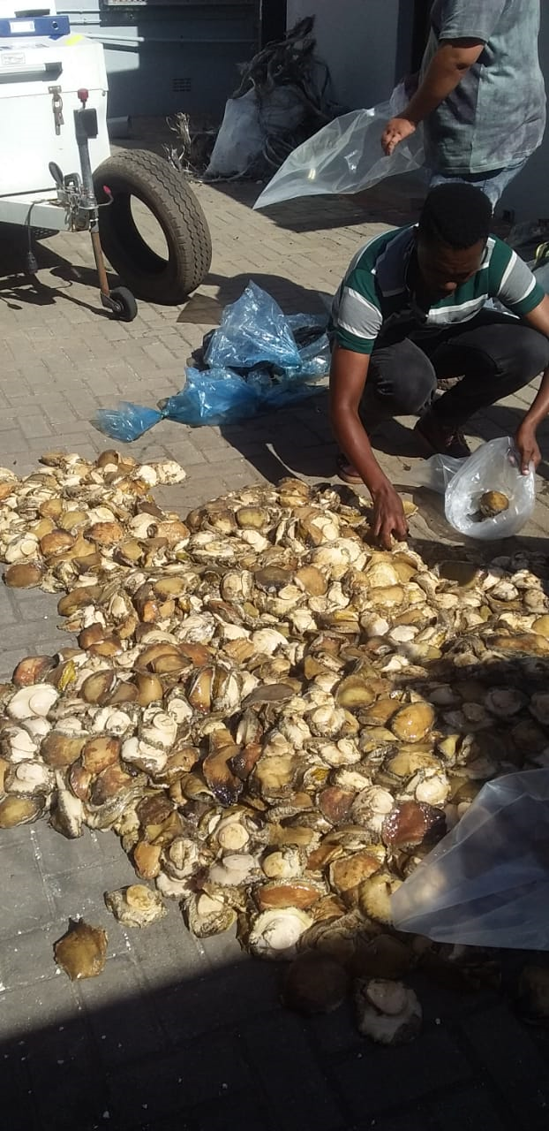
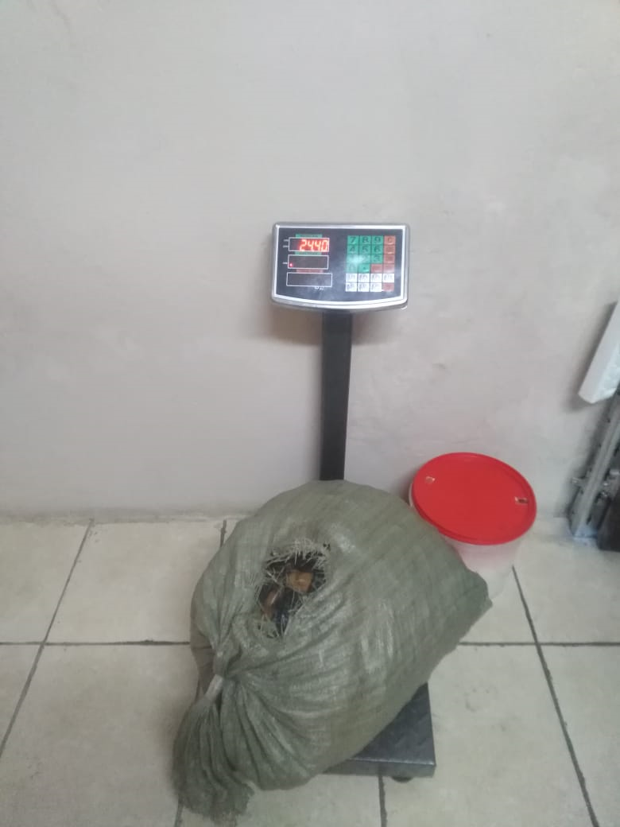
OUTCOMES OF OPERATIONS
PROVINCE | NUMBER OF JOINT OPERATIONS | NUMBER OF FINES | AMOUNT OF FINES | CASE DOCKETS REGISTERED | NUMBER OF ARRESTS
WESTERN CAPE | 5 | 17 | R4 200.00 | 32 | 05
EASTERN CAPE | 3 | 16 | R33 400.00 | 35 | 32
NORTHERN CAPE | 5 | 24 | R20 400.00 | 19 | 29
KWAZULU-NATAL | 4 | 93 | R64 000.00 | 71 | 22

Slide 13
ACHIEVEMENTS
CONFISCATIONS – MARINE RESOURCES
ITEM | QUANTITY | VALUE
Abalone (dry and wet) | 44 557 | R13 706 245.77
Rock lobster (whole) | 2796 | R291 299.10
Rock lobster (tails) | 12 | R6 000.00
Shell fish (Mussels, limpets, Oyster, Alikreukel) | 509 | R16 924.00
Prawns | 692 | R21 000.00
Line Fish (various species) | 3480 | R1 487 310.00
TOTAL |  | R15 528 778.80

Slide 14
ACHIEVEMENTS
CONFISCATIONS - EQUIPMENT
ITEM | QUANTITY | VALUE
VEHICLES | 11 | R1 510 000.00
TRUCKS | 1 | R1 500 000.00
FRONT LOADERS | 1 | R1 500 000.00
BOATS | 3 | R1 900 000.00
RING NETS | 3 | R6 100.00
GILL NETS | 21 | R10 238.00
BOSCH ENGINE (HAMMER MILL) | 1 | R80 000.00
TOTAL |  | R5 156 338.00
Other confiscations: Dagga, Mandrax, Sahawi Blue Master Cigarettes, Carton 777 Cigarettes, Hookah pipes, Vape units, Grandpa carton, Dry Mangoes, Dry Bananas, Mix nuts, Jelly sweets – Worth R25 785.00

Slide 15
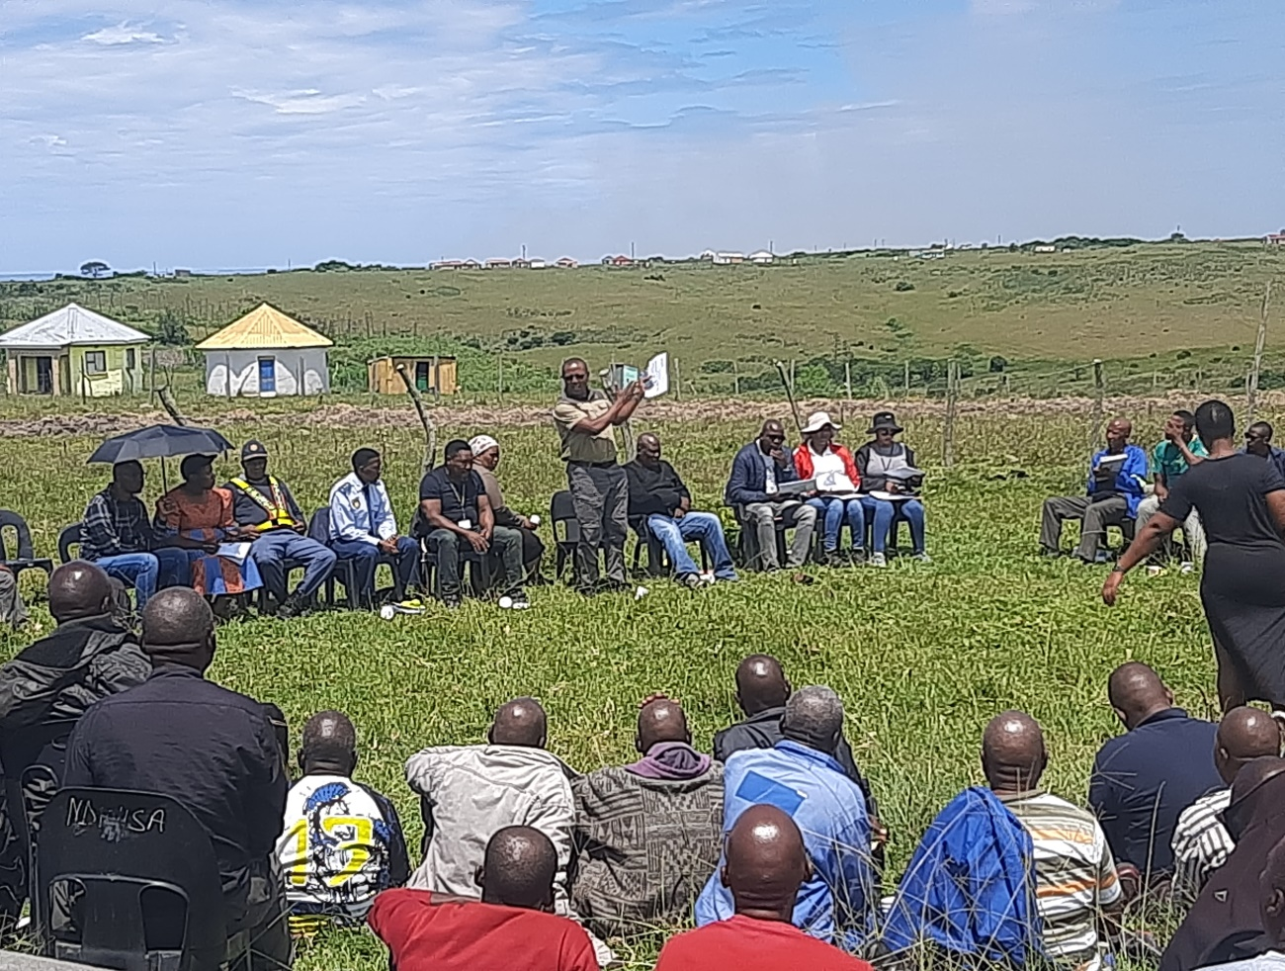
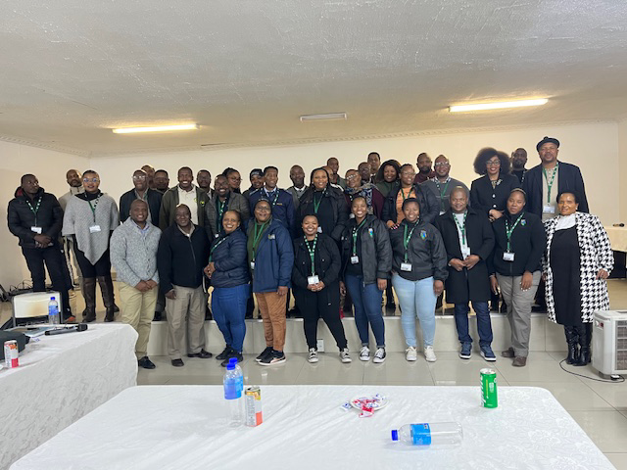
OTHER ENGAGEMENTS WITH PARTNERS
TRADITIONAL COUNCIL ENGAGEMENTS
KZN – 04 November 2024 – Illegal developments and ORV’s in coastal areas in KwaNzimakwe
05 November 2024 – Illegal developments and ORV’s in coastal areas in Macambini TC
EC- 06 October 2024 – Illegal developments in Gomolo A/A, Ndluzula TC Port St. Johns
08 October 2024 – Illegal developments and sand mining in Mpande
10 October 2024 - Illegal developments in Kwa- Ginqgi
JUDICIARY AND NATIONAL PROSECUTING AUTHORITY WORKSHOPS
KwaZulu-Natal: 26 – 27 February 2024 - 56 Participants
Eastern Cape: 09 – 10 September 2024 – 54 Participants

Slide 16
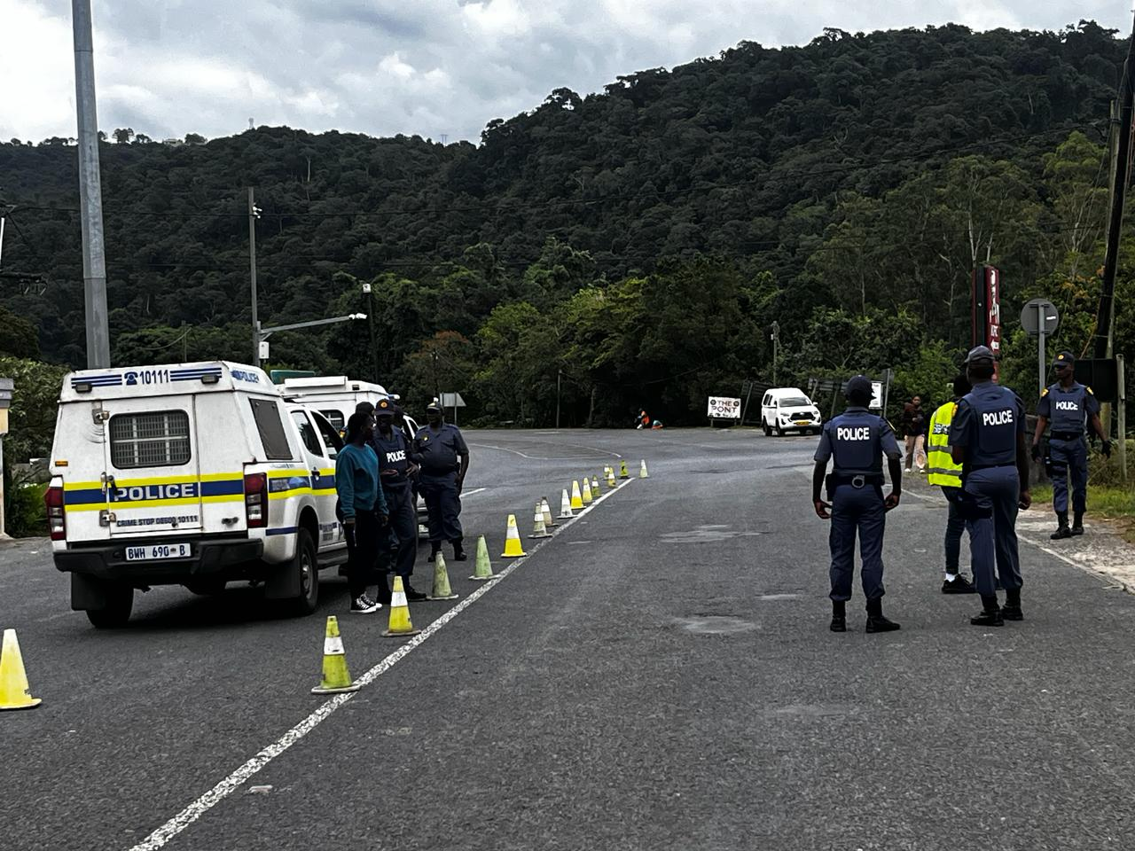
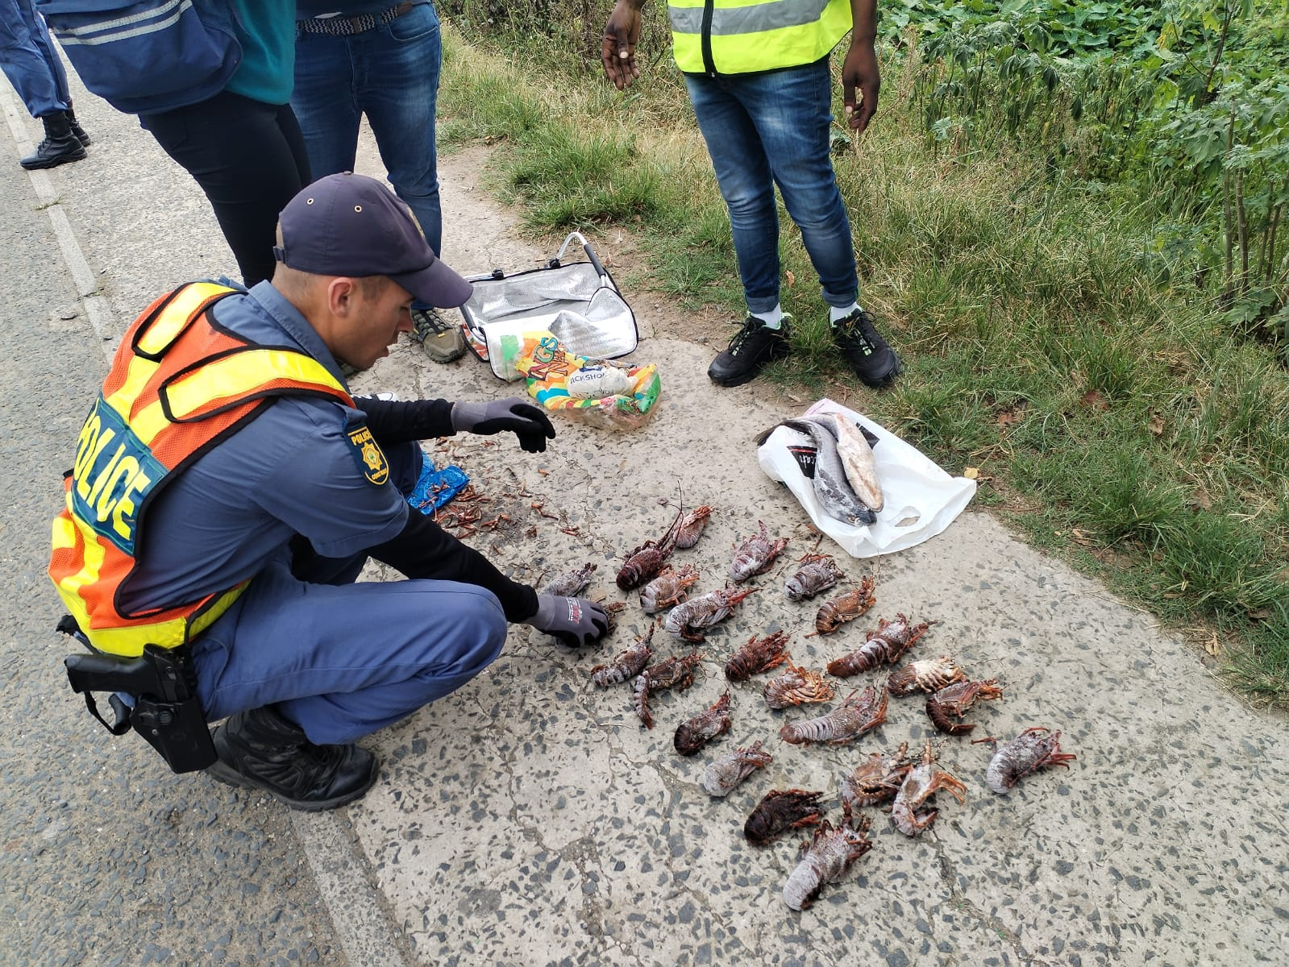
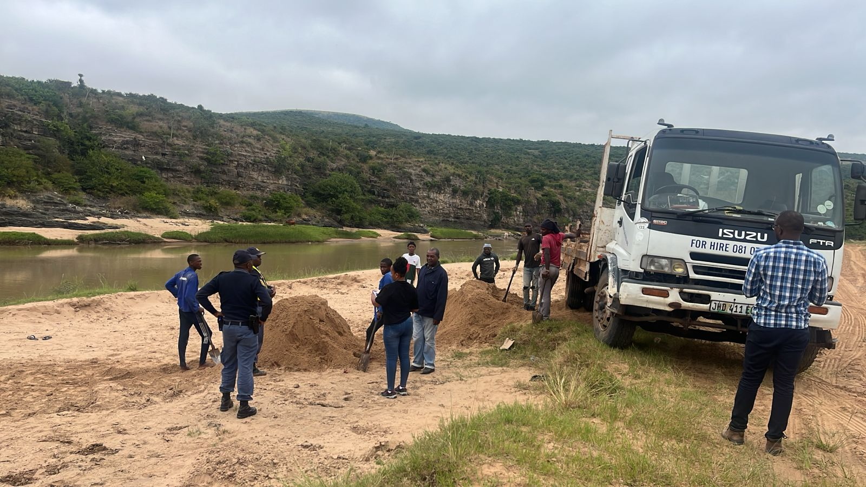
JOINT OPERATIONS

Slide 18
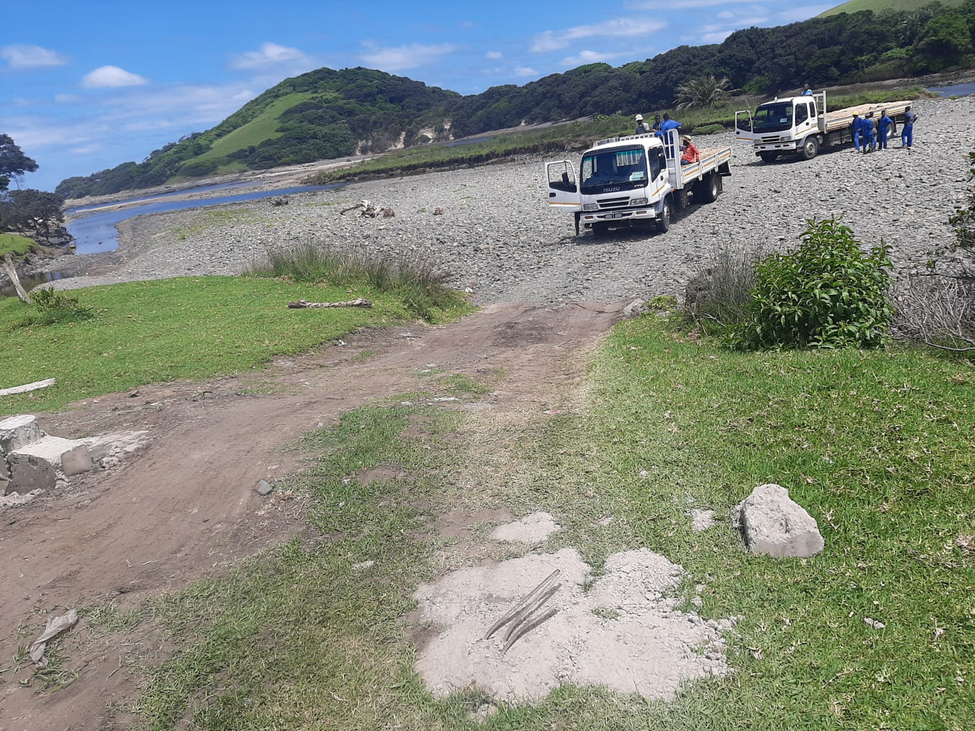
AREAS/ OPPORTUNITIES TO IMPROVE THE WORK OF THE INITIATIVE
Lack of participation by Local Authorities
Air support/surveillance
Financial resources for more operations
Difficulty to make use of local SAPS
Dealing with syndicate - Poaching of Marine Resources
Sand mining:
  Legal mining sites,
  Confiscation of machinery and
  Storage of big machinery

Slide 19
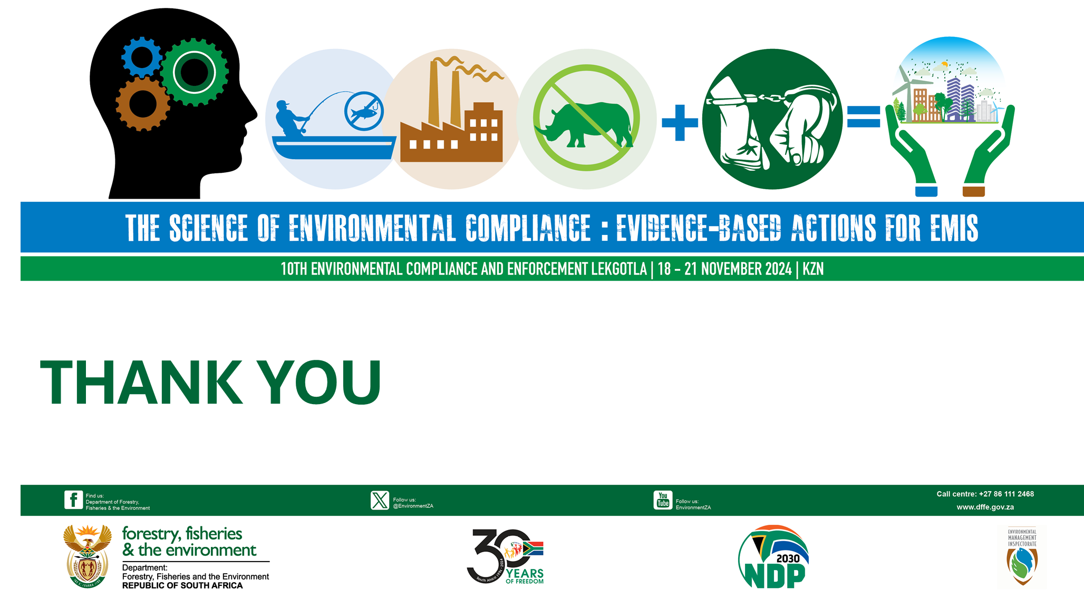
Mzondeleli Dlulane
Director: Enforcement Oceans and Coast
Email: mdlulane@dffe.gov.za
Tel. 071 605 2201

