Slide 1
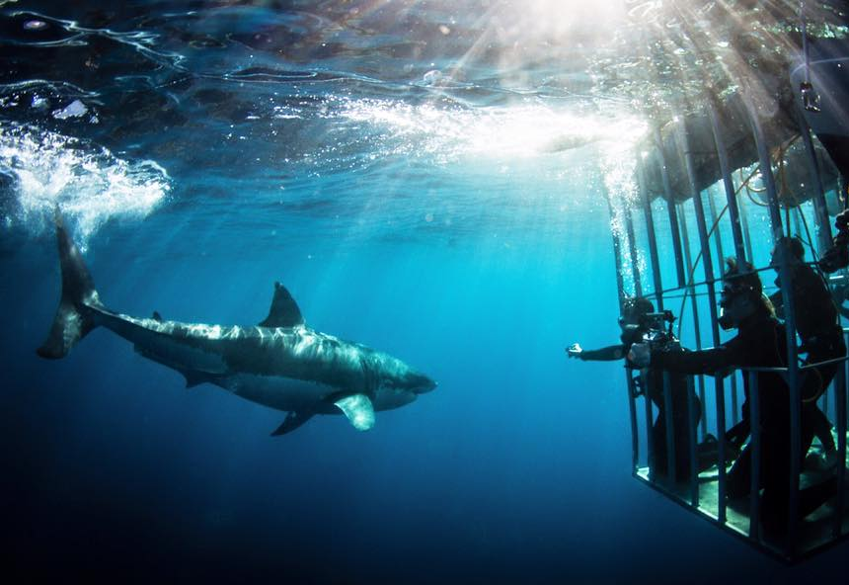
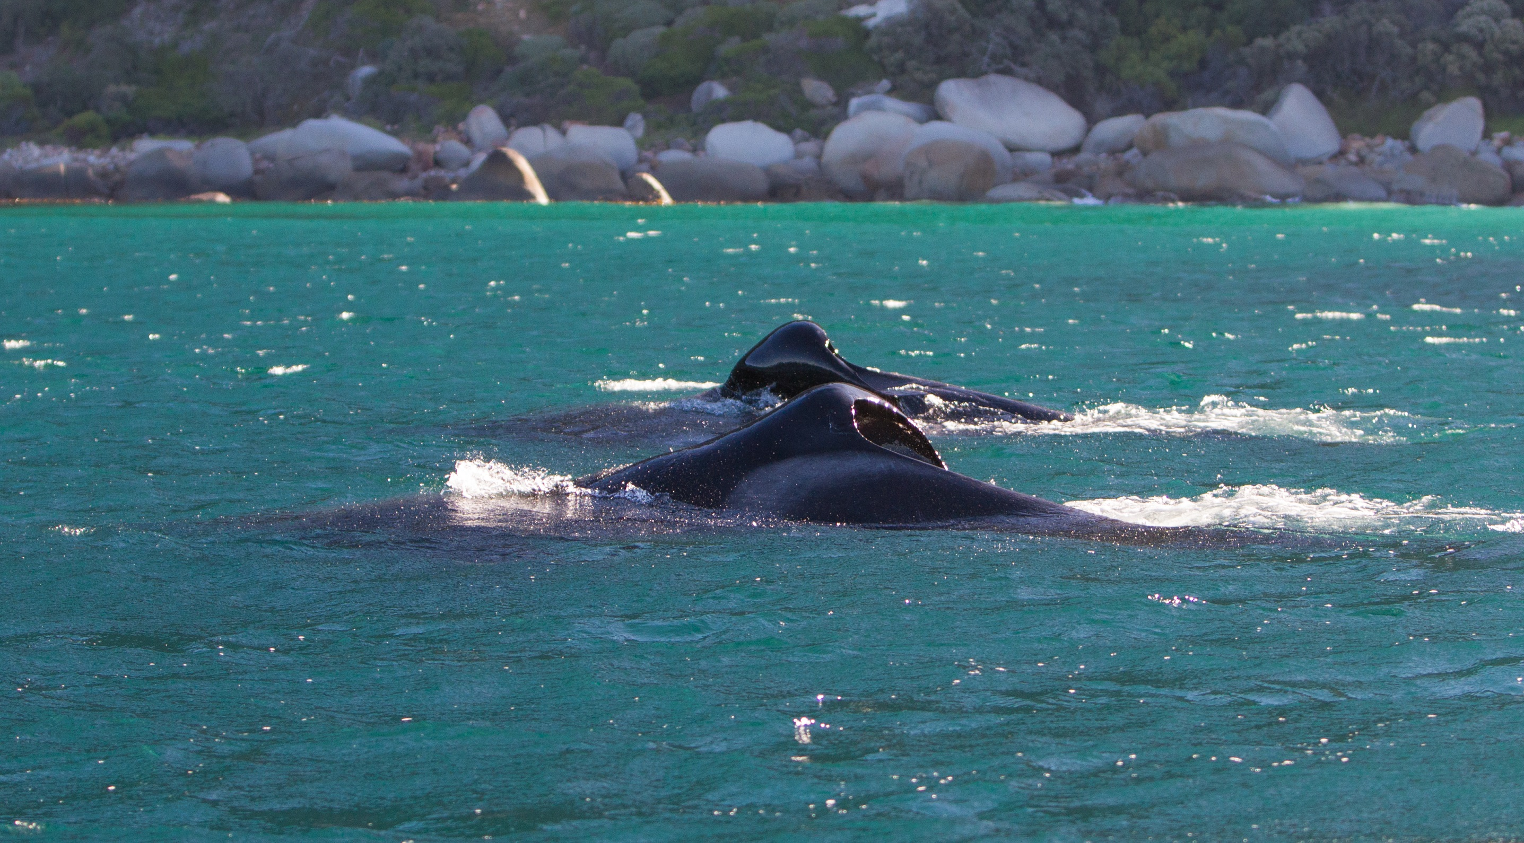
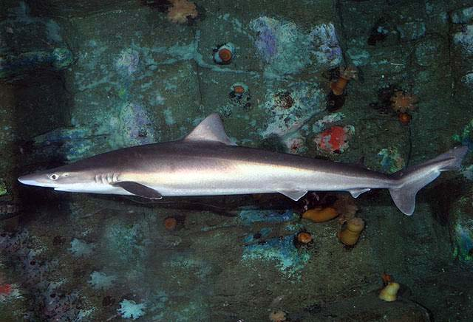
The disappearance of white sharks: weighing up the evidence

Slide 2
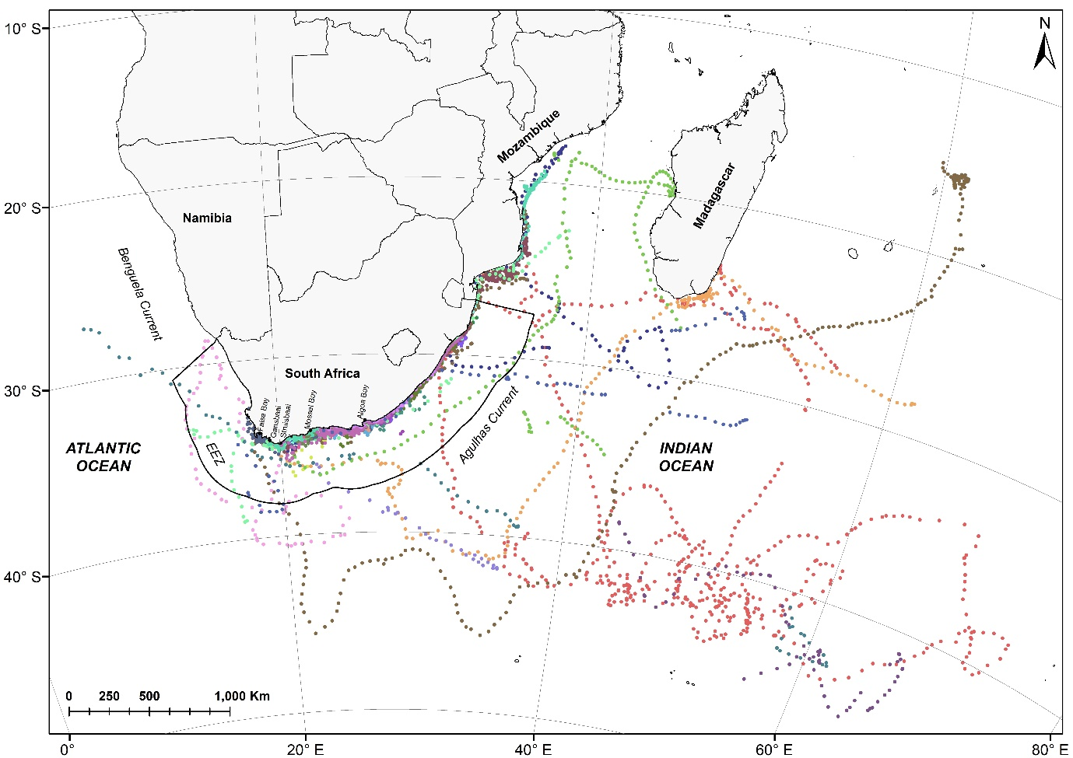
White shark movement is diverse
Patterns
Seasonal
Cyclical
Individual
Other
Drivers
Life-history
Environmental
Prey availability
Predation risk
Other
Kock et al. in prep

Slide 3
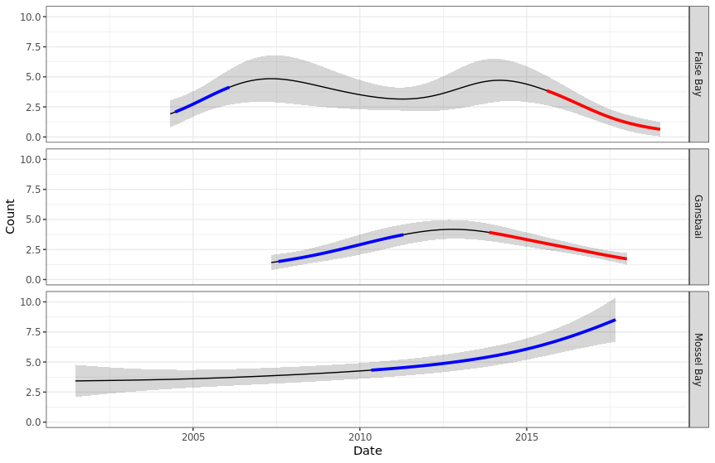
White shark occurrence at 3 major aggregation sites
Steep & rapid decline at False Bay & Gansbaai
Not a decline at all sites in SA
Mossel Bay increase over similar period
Plettenberg Bay & Algoa Bay regular white shark sightings
Source: Dylan Irion et al. PhD in progress

Slide 4
Killer whales ‘Port’ & ‘Starboard’ predate on white sharks
5 white sharks killed by killer whale pair in 2017, another in 2020
Likely more killed that did not wash up
Not all killer whales have same impact on sharks

Slide 5
Impact of killer whales ‘Port’ & ‘Starboard’
Orca predations in 2017
Source: Alison Towner et al. PhD in progress

Slide 6
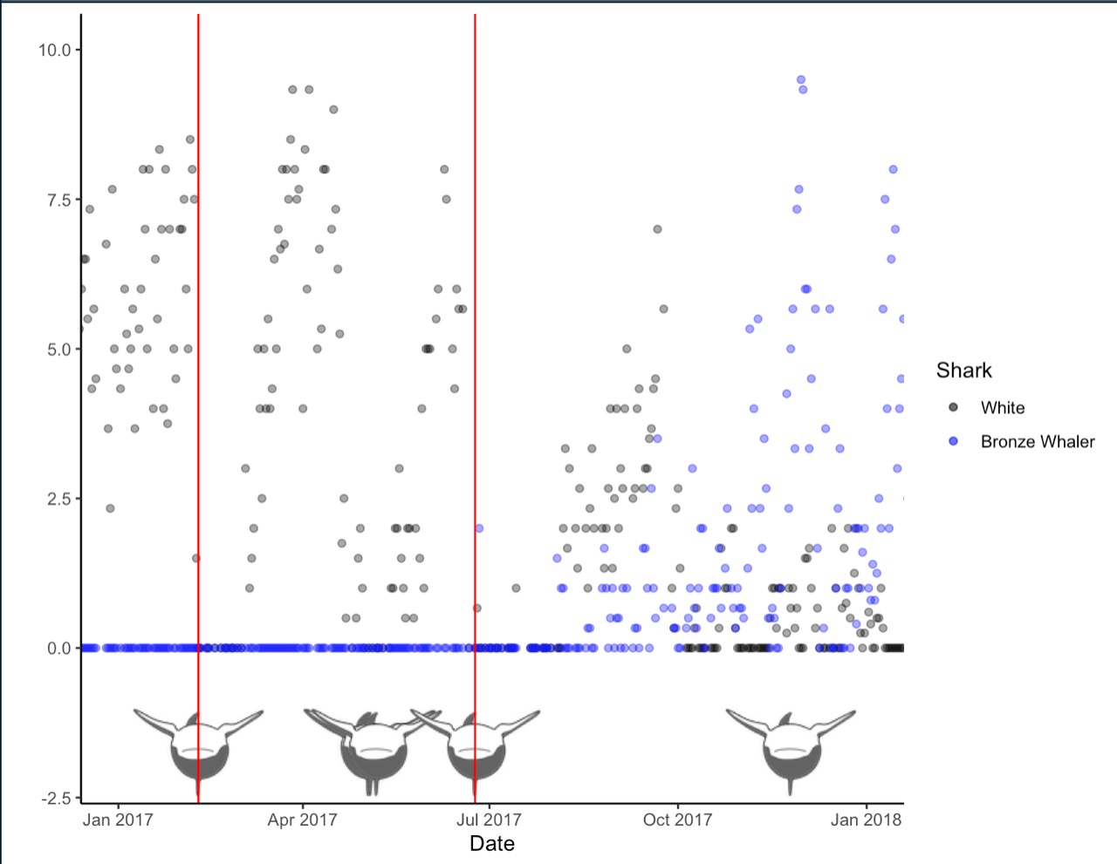
Impact of killer whales ‘Port’ & ‘Starboard’
Red lines = Orca predation in 2017
Each time this pair of killer whales was present in Gansbaai - white sharks washed up dead or fled (Towner et al. in prep)
Source: Alison Towner et al. PhD in progress

Slide 7
Reported sightings of ‘Port’ & ‘Starboard’ in SA
> sightings over time
Most sightings FB & GB
Source: Dave Hurwitz, unpublished data

Slide 8
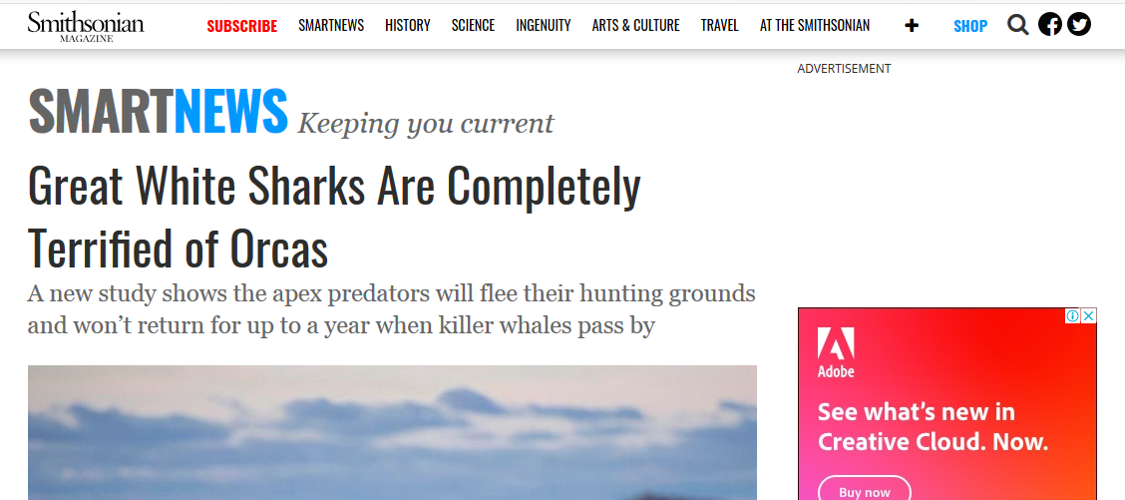
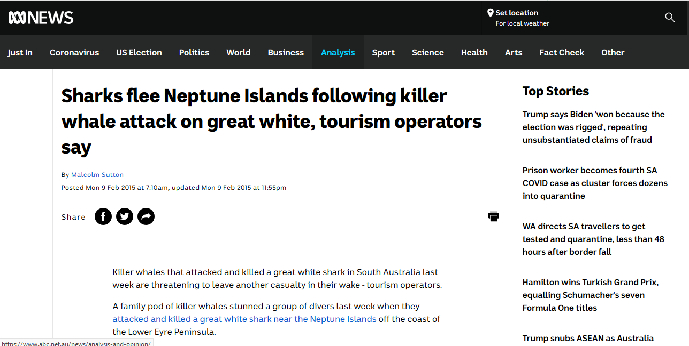
Significant impacts of killer whales reported on white sharks in other areas around the world

Slide 9
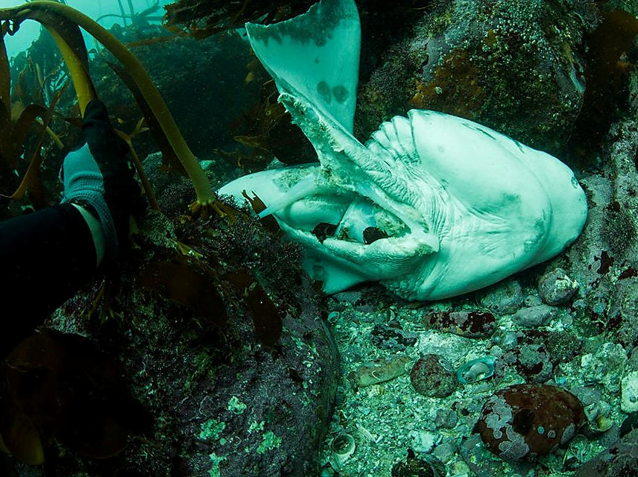
Significant impacts of killer whales reported on other sharks
Predated sevengills
Millers Point, False Bay
Nov 2015
Predated sevengills
Millers Point, False Bay
April 2016
Source: Tammy Engelbrecht et al. PhD in progress

Slide 10
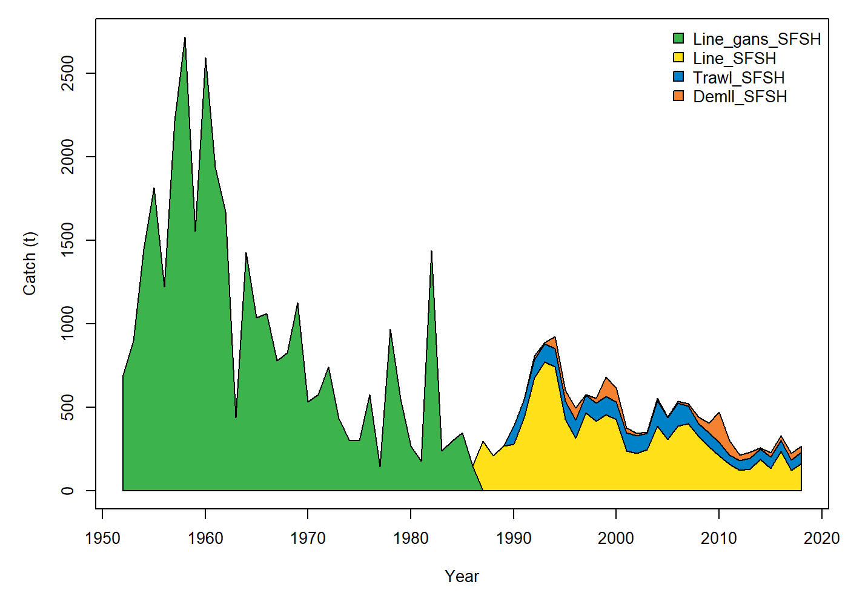
Investigating a link between the demersal shark longline fishery & white shark disappearance
WS start declining Gansbaai
Source: DEFF
WS start declining
False Bay
Soupfin sharks are Critically Endangered, but their steep decline preceded white shark disappearance

Slide 11
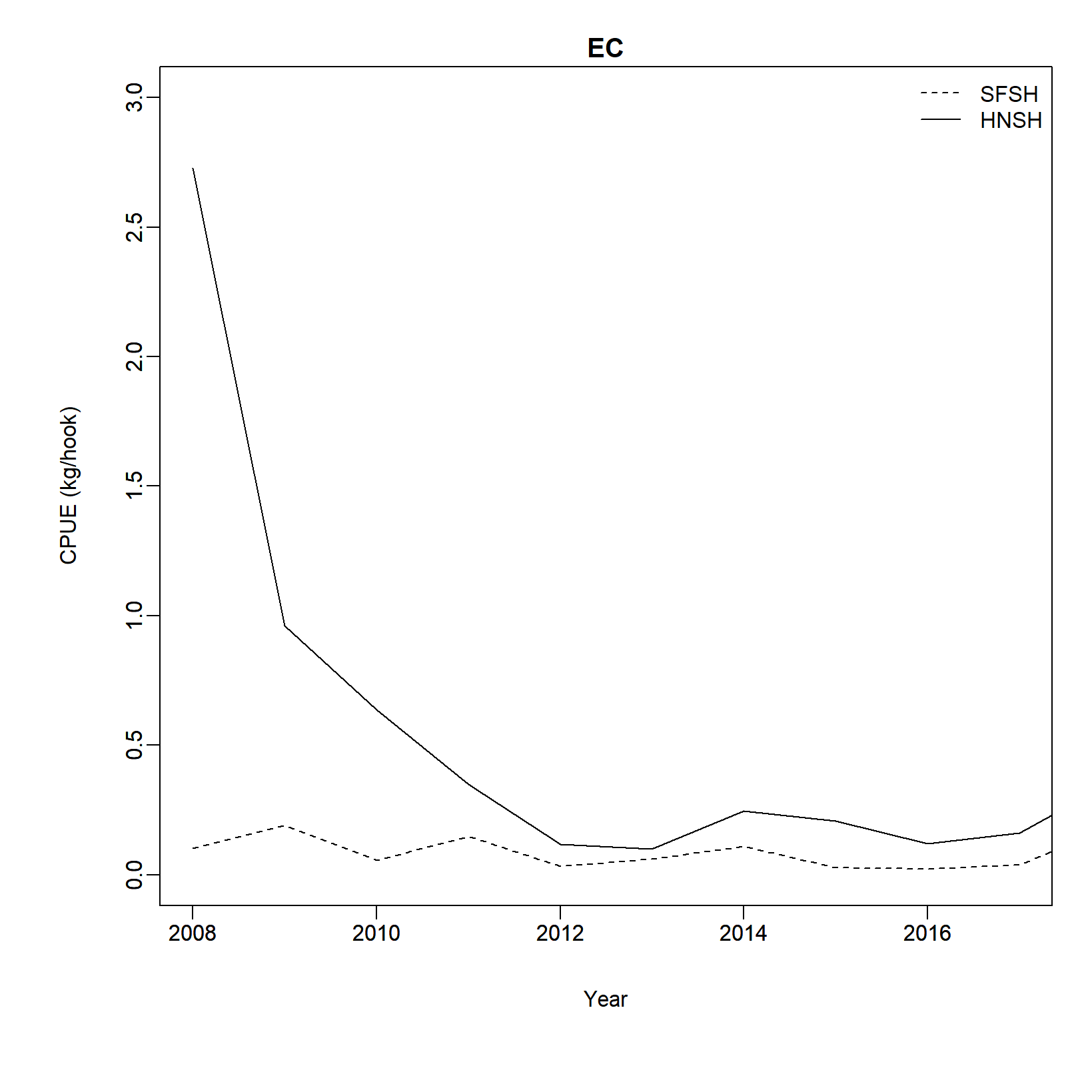
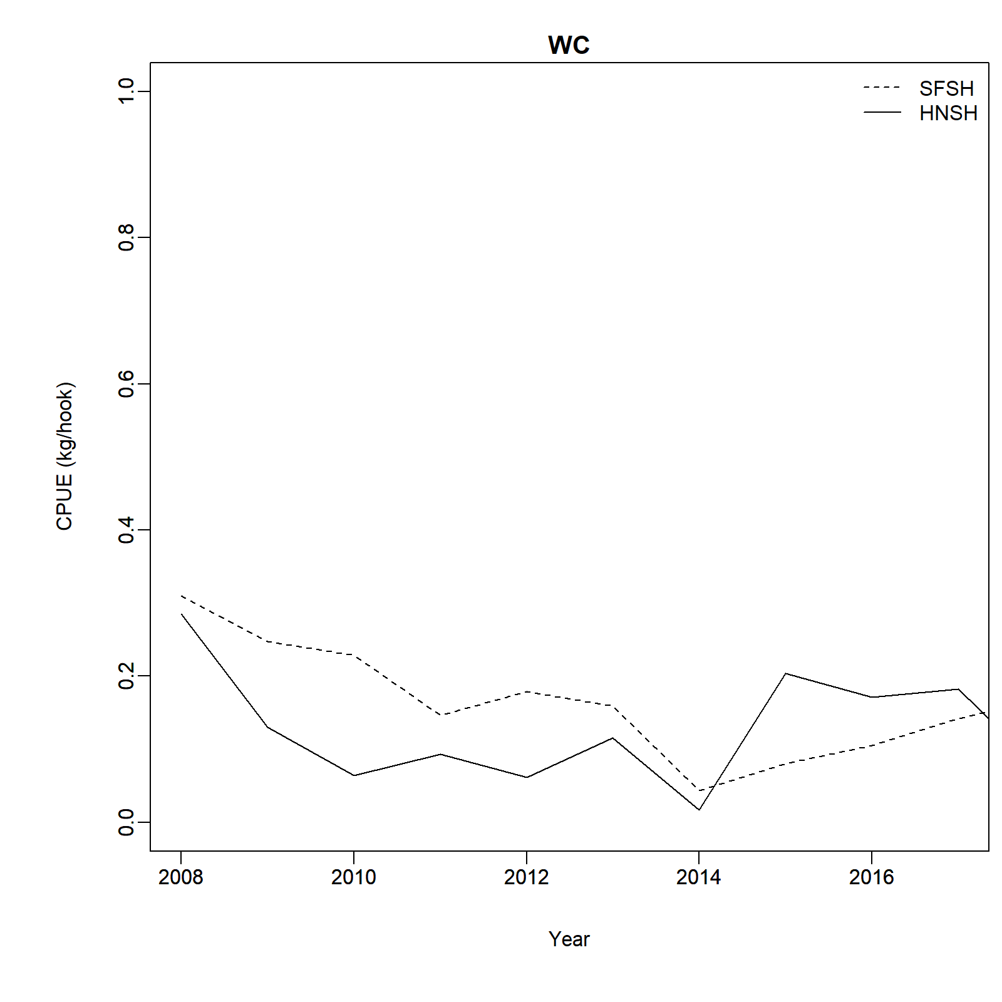
Demersal shark longline effort highest along Eastern Cape where white shark sightings are still common
Eastern Cape catches
Western Cape catches
Frequent white shark sightings in Plettenberg Bay & Algoa Bay (tour operators, water users, NSRI, fishermen)
WS start declining Gansbaai
WS start declining
False Bay
Average catch per unit effort (CPUE) (kg/hooks) for soupfin sharks (SFSH) & smoothhound sharks (HNSH) in the Eastern Cape 2007 - 2017
Average catch per unit effort (CPUE) (kg/hooks) for soupfin sharks (SFSH) & smoothhound sharks (HNSH) in the Western Cape 2007 - 2017
Source: DEFF

Slide 12
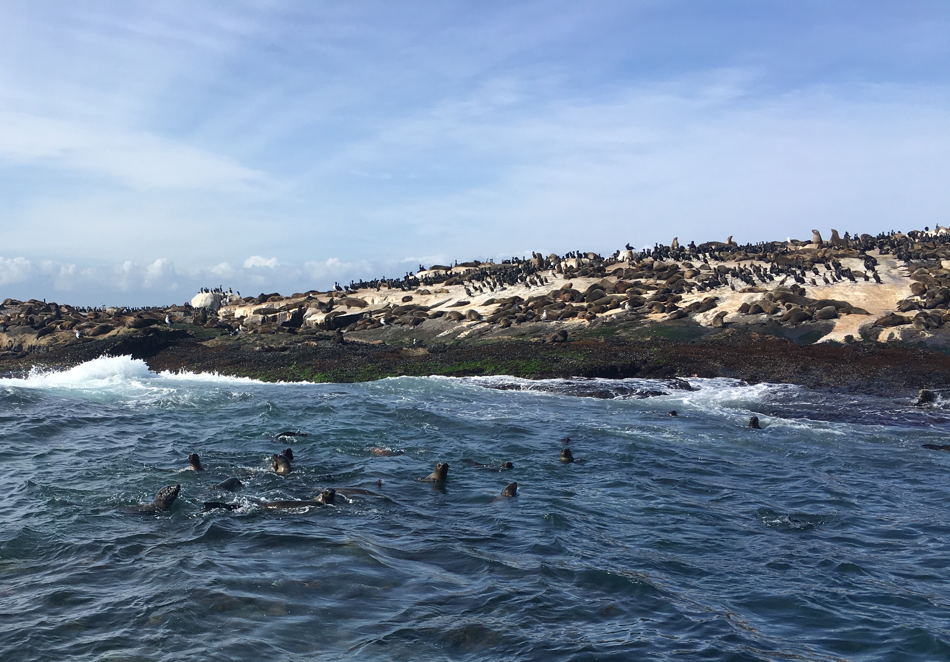
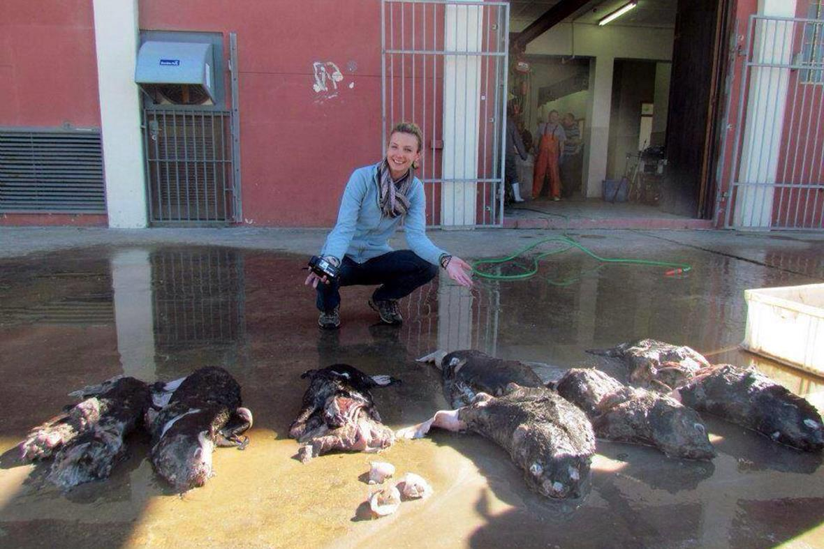
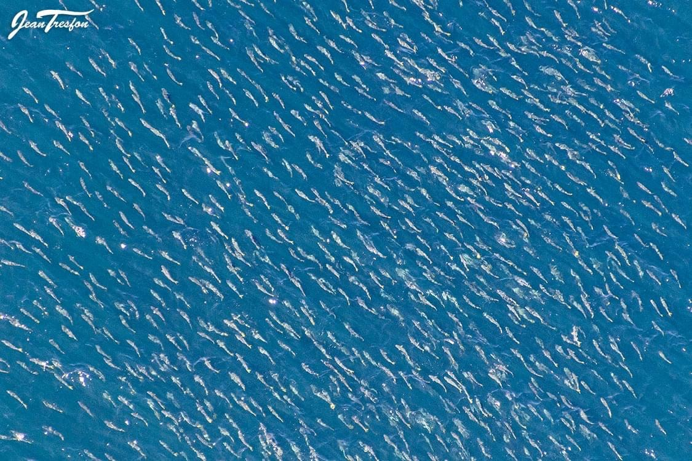
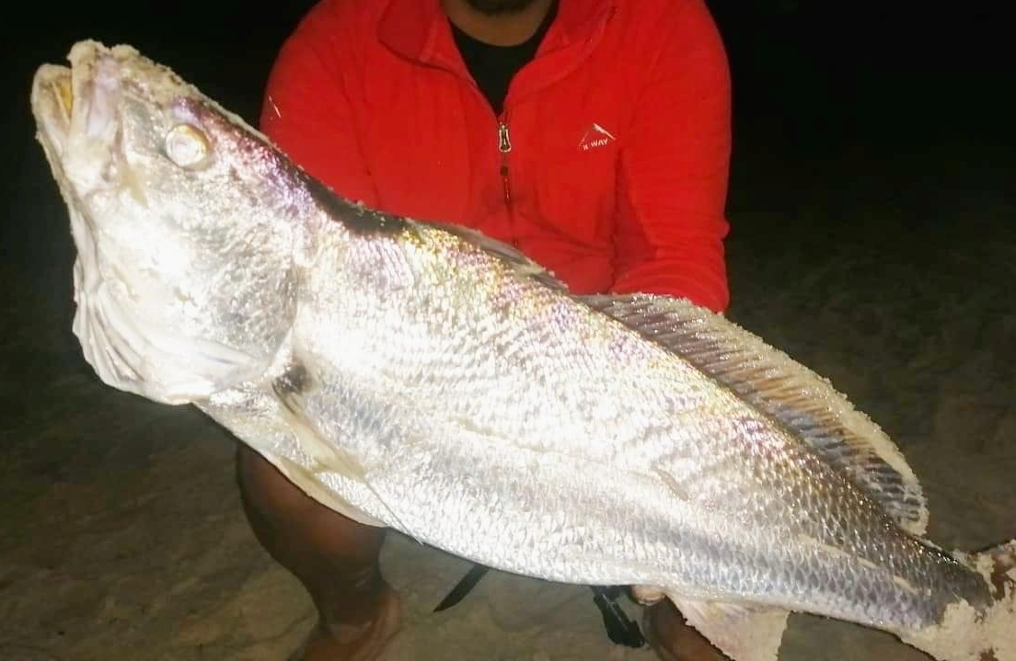
White shark diet & coastal resources
Elasmobranch species in white shark diet (Hussey et al. 2012)
Squalus sp.
Rhincodon typus
Carcharhinus obscurus
Carhcarhinus plumbeus
Rhizoprionodon acutus
Carcharhinus brachyurus
Sphyrnid spp.
Alopias spp.
Carcharias taurus
Rhinobatidae spp.
Rhynchobatus djiddensis
Dasyatidae spp.
Aetobatus narinari
Pteromylaeus bovinus
Manta birostris
Rhinobatus annulatus
Generalist & adaptable predators
Prey on >40 different species in South Africa
Cephalopods, teleosts, elasmobranchs, marine mammals

Slide 13
Recommendations
Investigation of the ecosystem effects of fishing on predators is needed & should be included in the updated NPOA
More investigation into the diet of white sharks, particularly in the Western Cape & ID other drivers of movement
Pooling of existing data from marine scientists to investigate large ecosystem changes & possible impact on white shark occurrence in short, medium & long-term
Investigation of killer whale occurrence, movement & diet to confirm impact on ecosystem & species

Slide 14
THANK YOU!
Dr Alison Kock
On behalf of the Shark Expert Panel as appointed by the Honourable Minister, Barbara Creecy
Marine Biologist
Cape Research Centre, Scientific Services
South African National Parks
Email: alison.kock@sanparks.org
@Urbanedgesharks
Website: https://www.sanparks.org/scientific-services

